Slide 1


Delivering Excellent
Operational Performance
Briefing Materials Guide

Slide 2
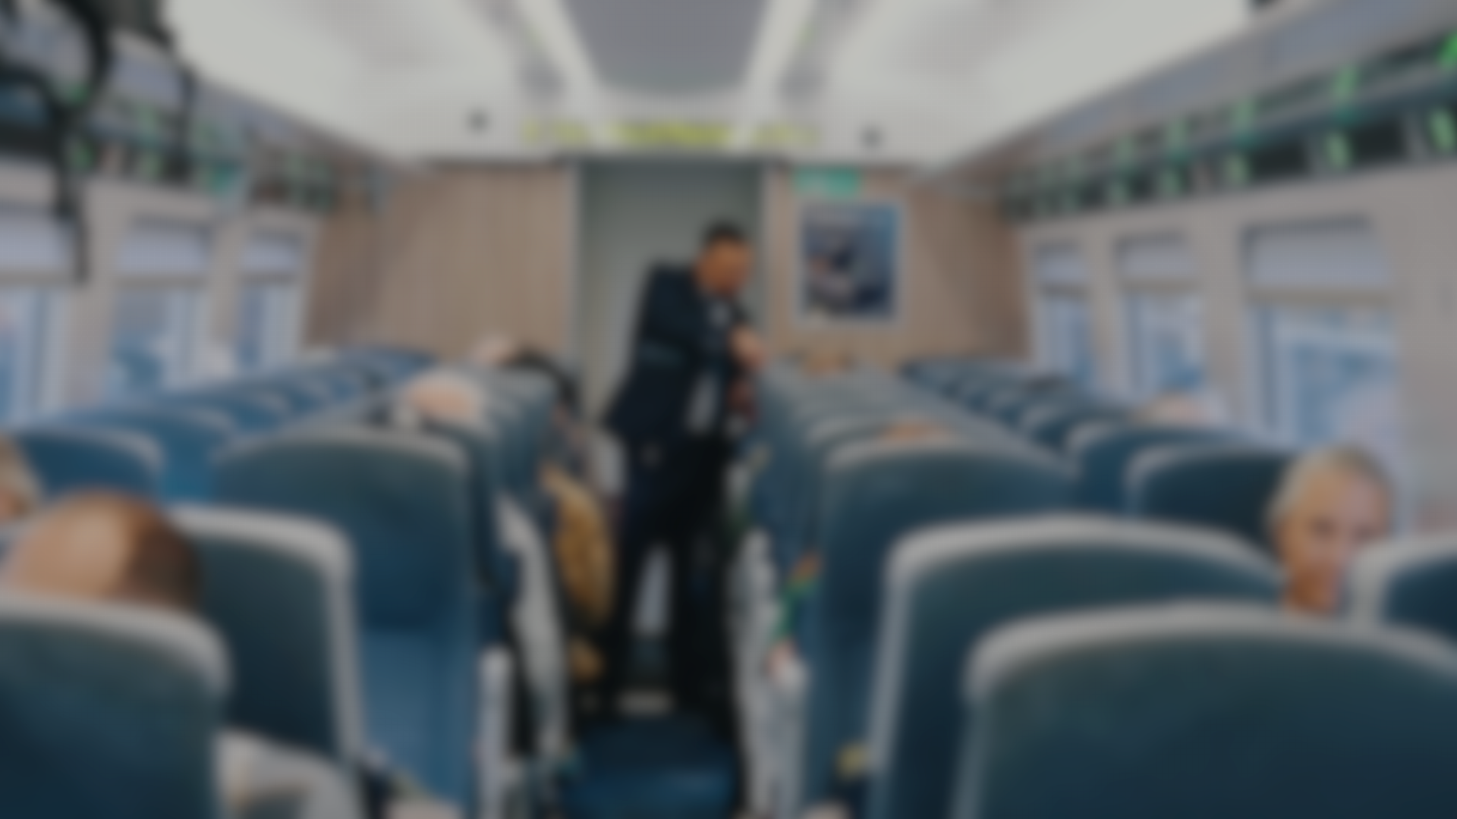
  A series of role specific videos and
  supporting structured discussion material
The package is intended to improve the standard of railway operating practices to enable adherence to the operational plan reflecting that:
1
2
3
Effective railway operating is dependent on cohesive and complementary contributions by operational staff who may not see the impact of their behaviours across the wider network and the impact of their actions on others.
Minor delays, when repeated, can propagate into significant out of course running, generating reactionary delay with its associated performance impacts.
Prompt contributions by individuals can mitigate incidents and assist with effective, safe service recovery.

Slide 3

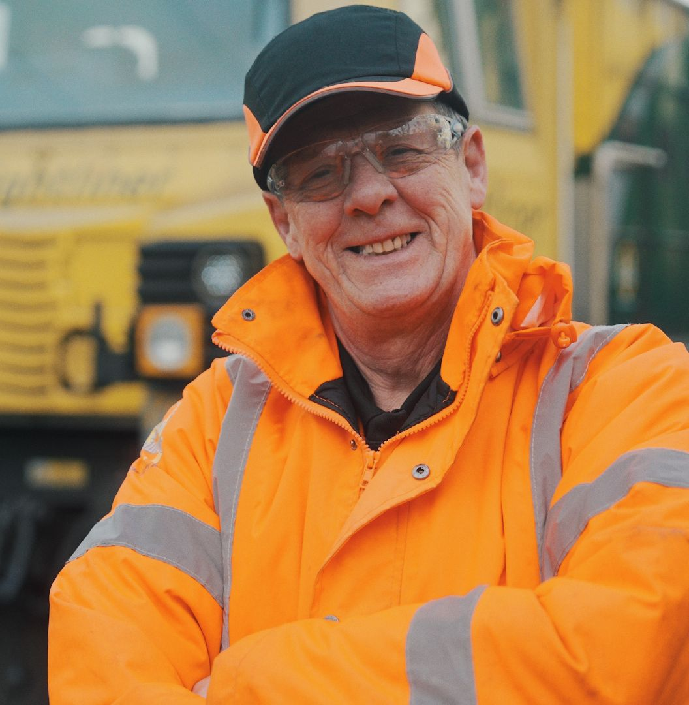
Format

Slide 4

White Label Material
Neutral branding so can be branded as desired
For example: TOC and NR routes – to reflect the programme is about cross-functional and cross-industry performance focus
Consider use of joint branding
To include senior management endorsement and statement on the local performance situation/importance e.g. from TOC MD, RMD
Introductory Slide

Slide 5


Delivery Methods

Slide 6


Led by local managers
Training to be led by local functional managers (not training team), to show line-management commitment.
Cross-functional training of benefit when different teams/roles routinely work very closely together. Give better appreciation of how their actions impact on others.
Formats include:
  Different roles together for common briefing session of all related videos
  Single-role groups viewing other functional videos
Using “Post-it” notes etc and through discussions Briefers to generate:
  actions from their team members to improve performance
  how these actions will be achieved
  any associated “lead measure” analysis

Slide 7

In person delivery
Trainers to contextualise videos using supporting discussions and real local scenarios:
  Local challenges reflecting current issues
  Relevant processes and methods of working
  Resource disposition etc…
Sessions should be interactive and “in person” (not on Teams) to make use of discussion, rather than being a briefing.
To start hold a general discussions on:
  What good performance looks like
  What challenges and issues exist in the current operating environment
Towards session end you could ask:
  What could you/your team do differently to help performance?
  What do you think should happen in (sample scenario) circumstances?

Slide 8
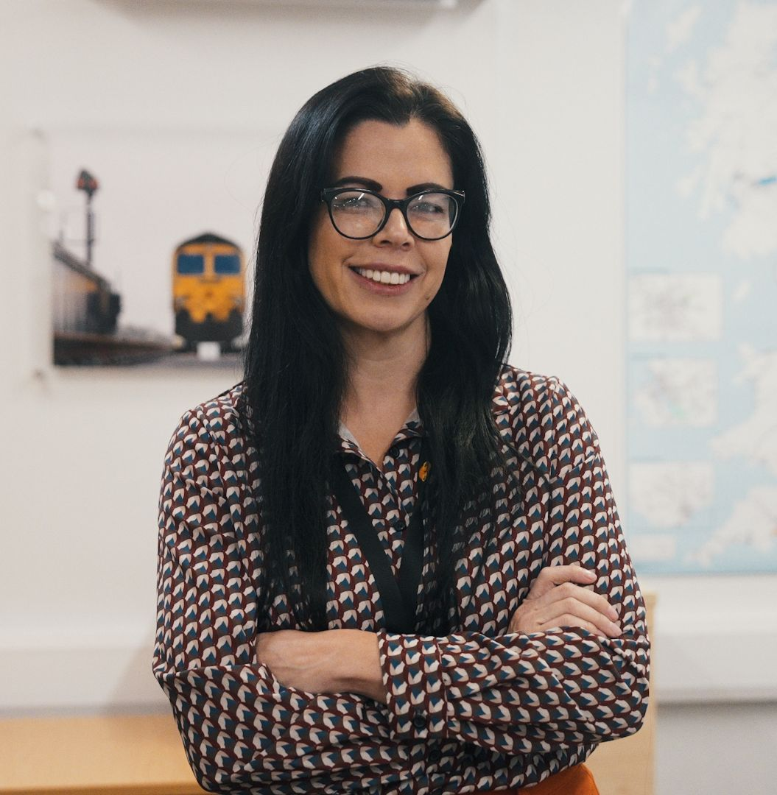
Key Messages and
Discussion Points

Slide 9

  What is performance?
There’s more to performance than the Performance Regime and the Delay Attribution budgets.
Prevention
Mitigation
The prevention of incidents across the rail network.
The mitigation of incidents when
they do occur.
Ask: How do you help with prevention and mitigation in your role?

Slide 10

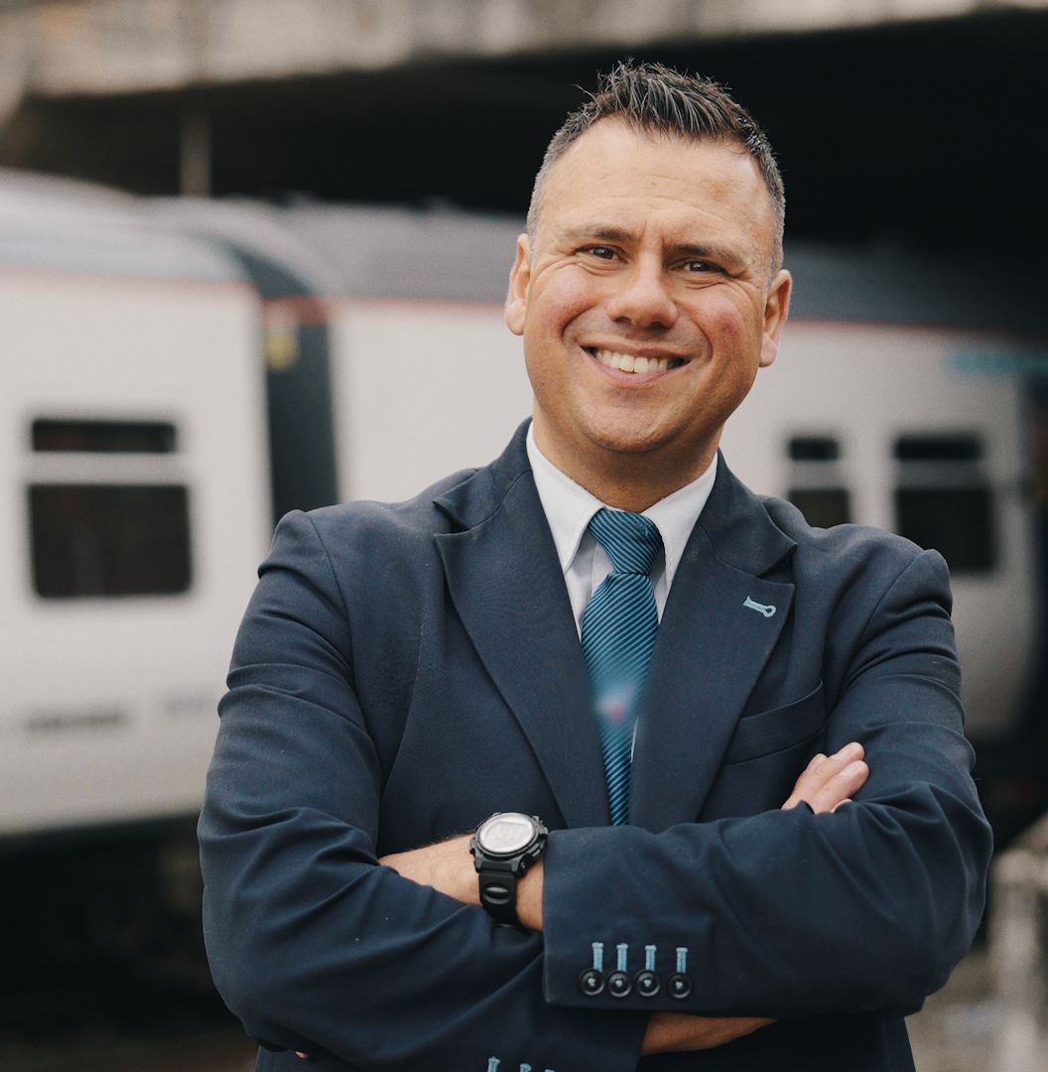
  Impact on revenue
Ask: How does performance and performance
decisions impact on customer experience and thus revenue?

Slide 11
  It’s important to remember that performance, safety and efficiency
Are not in conflict
Form a virtuous circle
  A high performing railway present trains on time at junctions leading to fewer restrictive aspects and lower SPAD risk

Slide 12


  Impact on people
Performance has real impacts on real people
“Actions (or in-actions) have consequences”
Be prepared to give some local examples of incidents in the relevant area
“What went through your mind and what was the impact on you, or your family and friends, when last delayed on a train?”

Slide 13
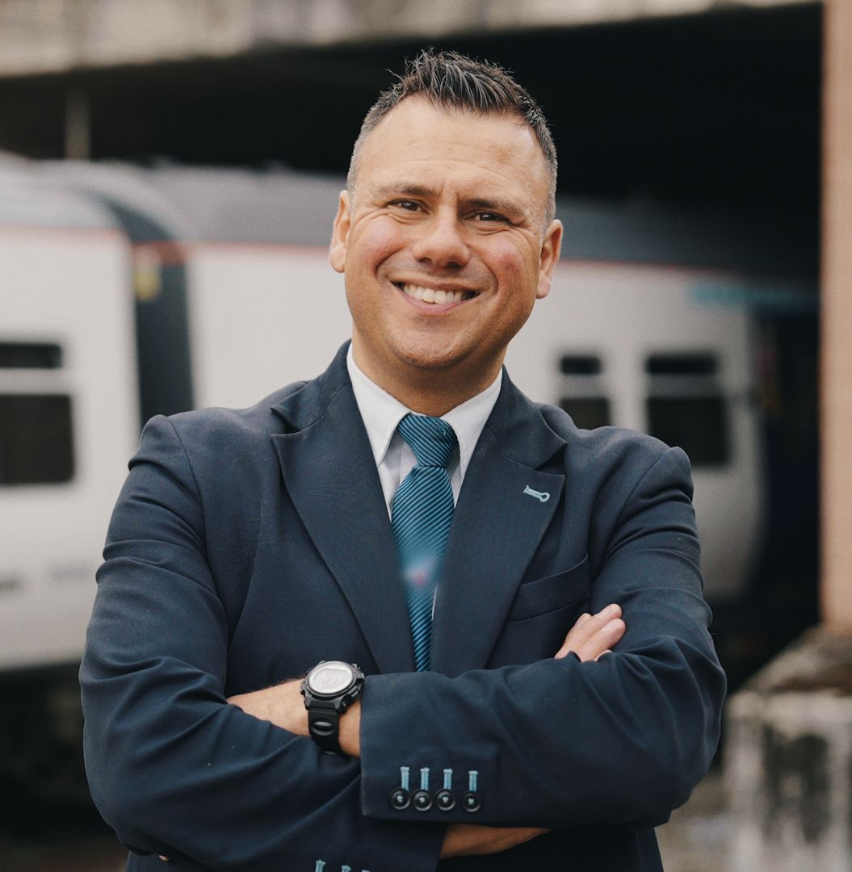
  Every Role Matters
It’s not just front-line jobs, but providers of resourcing support, management information etc. are equally critical to excellent operational performance.

Slide 14
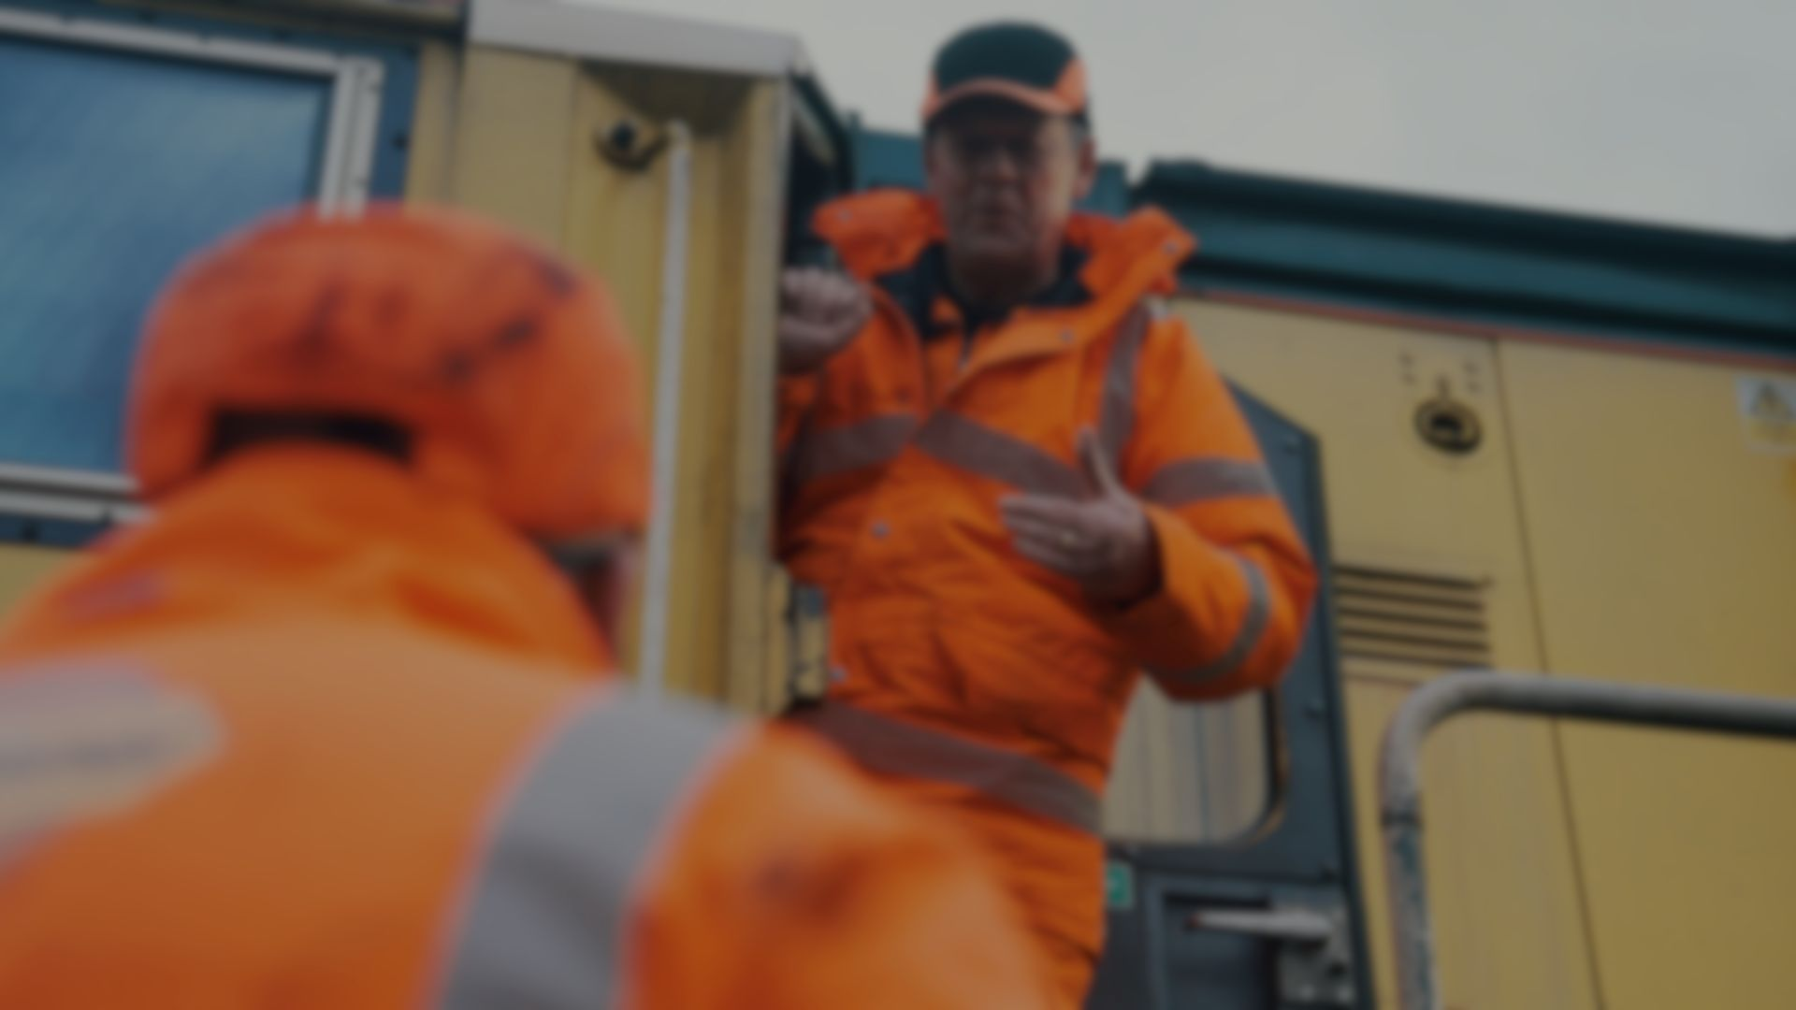
  Performance is a “Team Game”
It’s important to emphasise:
How impacts made by one role impact others
The risks of silo-working
Ask: What’s the impact of your decisions on colleagues and their working environment?

Slide 15
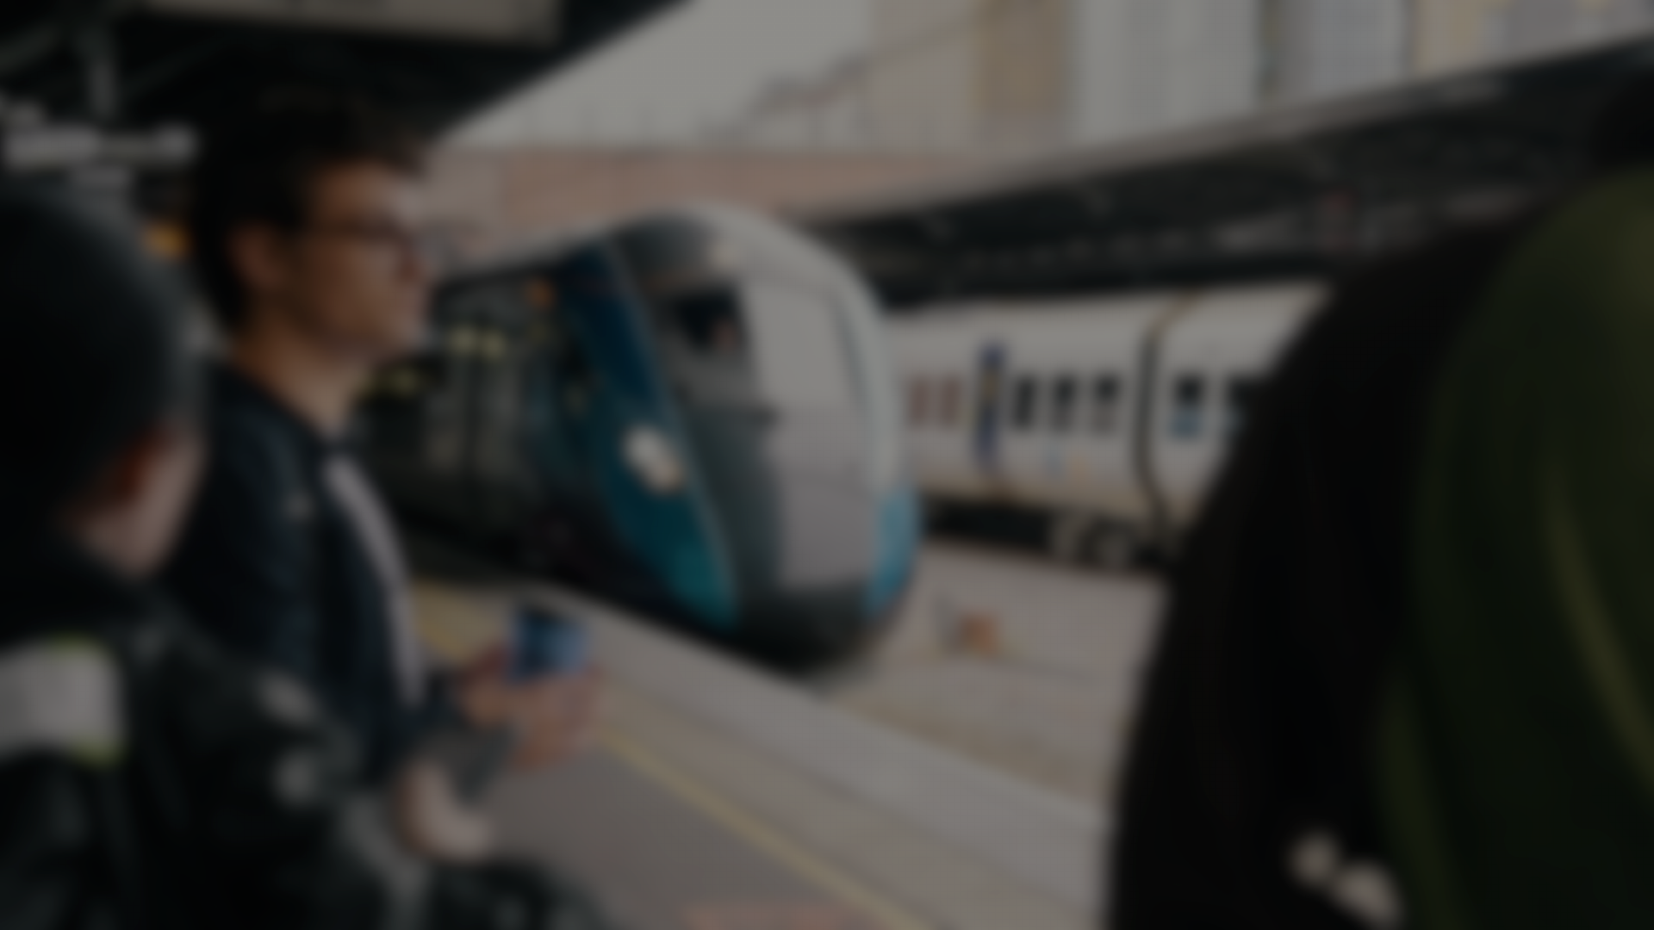
  What is within your control?
Not being in total control isn’t a reason to not act
Think “circles of control, influence and interest”
“Wear others shoes”, whether they’re customers or colleagues
Ask: What can you still do to help the situation, even if you don’t control all the factors?

Slide 16

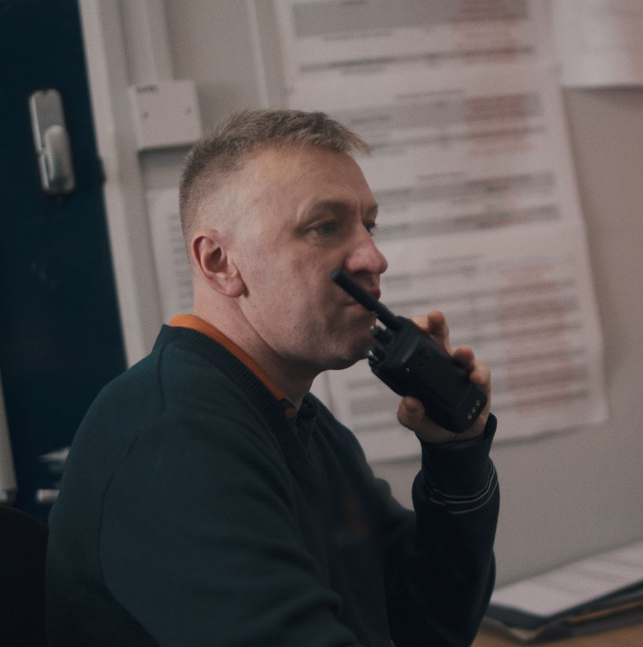
Doing the right thing
Doing the right thing isn’t always straight forward, there is always a range of factors to consider.
May involve difficult decisions and compromise
Be prepared to challenge – but then comply and get on with the job
Don’t be afraid to propose actions
Be proactive in developing solutions – but don’t act unilaterally without telling others of your actions
Use Keeping Trains Moving Safety principles where appropriate in an operational decision making environment

Slide 17


T3 Pass/Fail
It’s not a simple T-3 pass / fail. If a train has failed T-3 or is severely late consider this:
Don’t abandon it, it’s got valuable traffic on board
Real people are having their lives disrupted
Its resources will have a back working on that or another day
Think ahead beyond the incident itself
  Reactionary delay and collateral disruption, not just on the operational railway but e.g. at a freight terminal – disrupting commodity handling

Slide 18
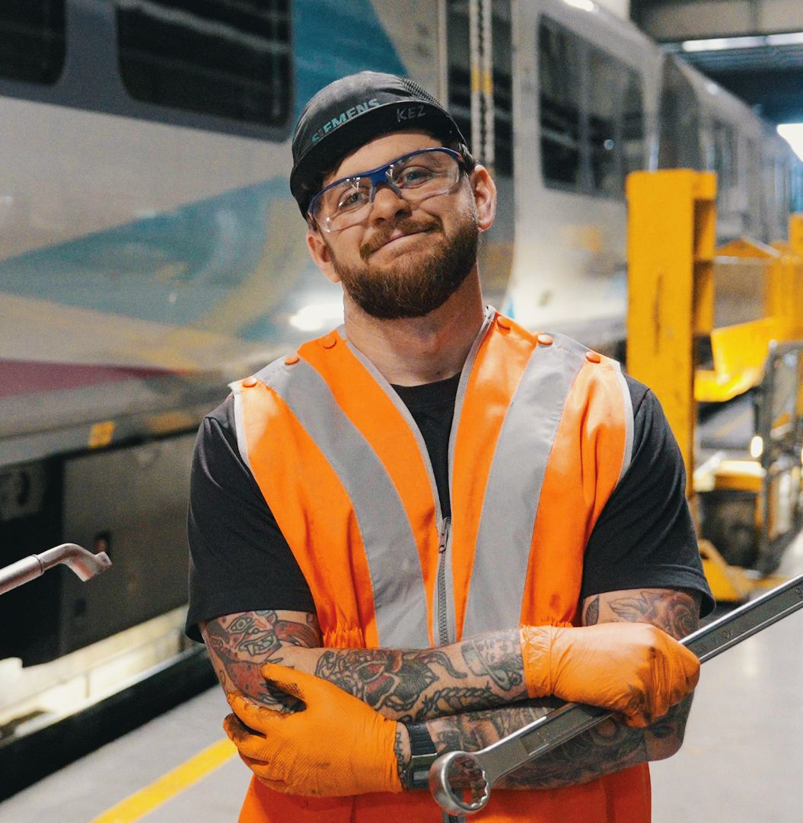
The Video Content

Slide 19
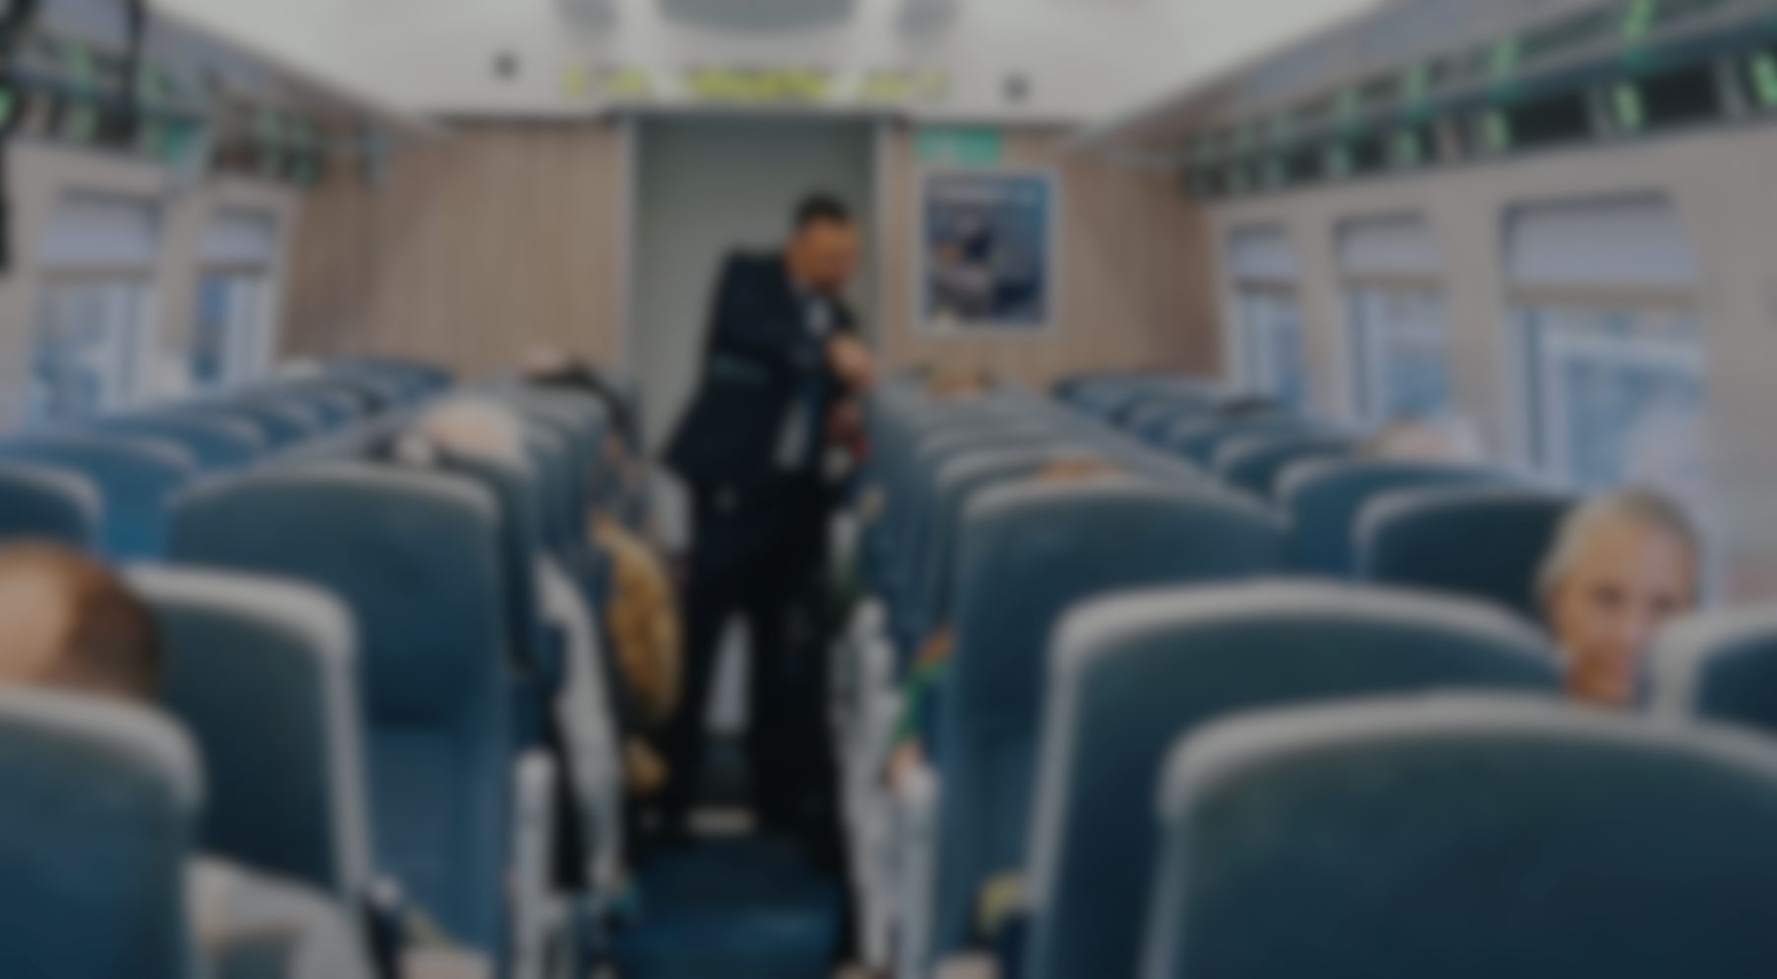
Featured Roles
01
Stations
05
Drivers
02
Depots and Stabling Locations
06
Signalling and Control
03
07
Planning and Resourcing
Infrastructure
04
On Board
08
Freight Operations

Slide 20

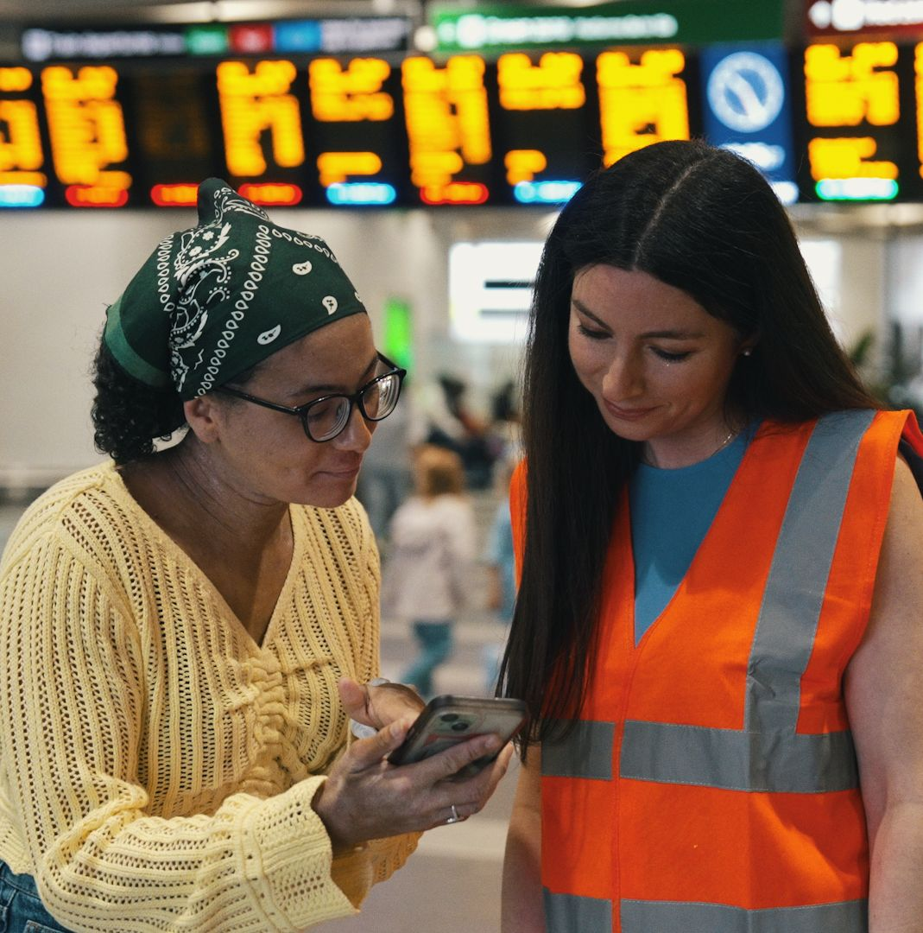
Discussion Points
Stations
Every action on the station can affect the whole network. Possible discussion points include:
“What small actions at your station can prevent delays from building up and affecting the wider network?”
“How does your specific role help passengers stay safe, informed, and in the right place at the right time?”
“Where do you rely on teamwork with other station or traincrew colleagues to keep trains running on time?”

Slide 21
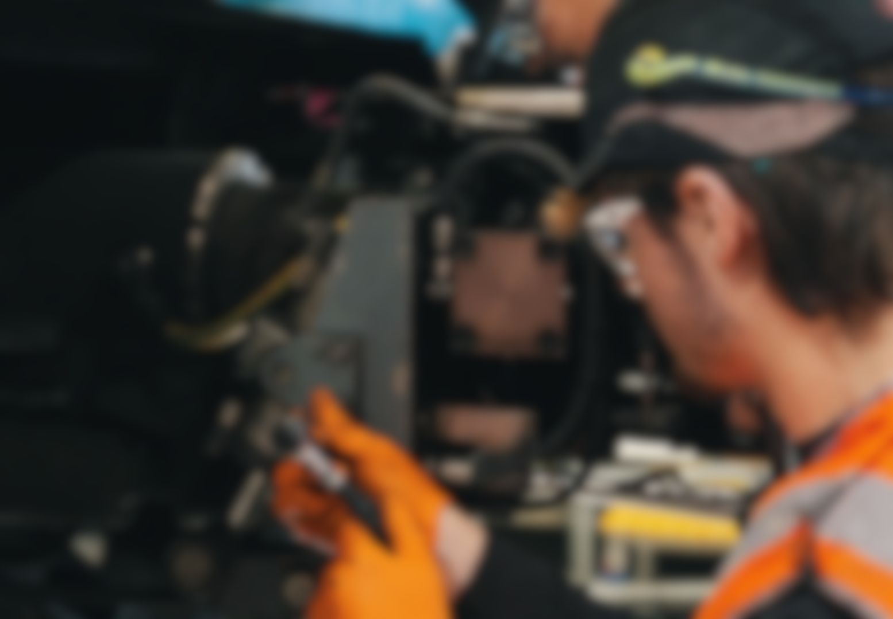

Discussion Points
Depots and Stabling Locations
Reliable trains start with the right actions at the depot. Possible discussion points include:
How do small actions in the depot, like spotting defects or ensuring correct train formations, impact passenger experience and on-time performance?
When unplanned defects occur, how can teams prioritise effectively while keeping the wider network in mind?
How does communication between depot staff, drivers, and control help maintain a safe, high-performing railway?

Slide 22

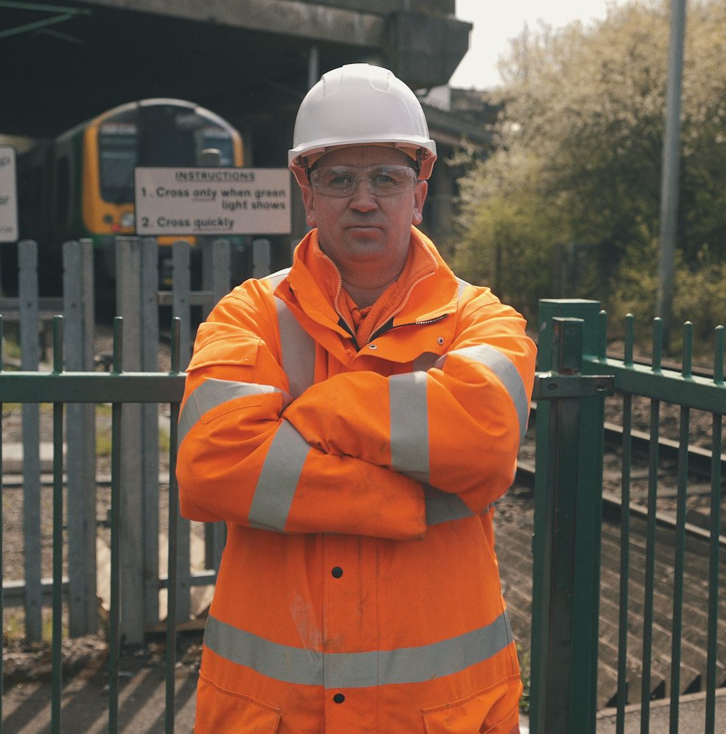
Discussion Points
Infrastructure
Resilient infrastructure keeps trains and freight moving on time. Possible discussion points include:
How can proactive infrastructure management prevent delays and improve the passenger and freight experience?
What decisions can be made on-site to maintain safety while minimising disruption to services?
How does communication between PICOPs, engineers, and Control support a high-performing railway?

Slide 23

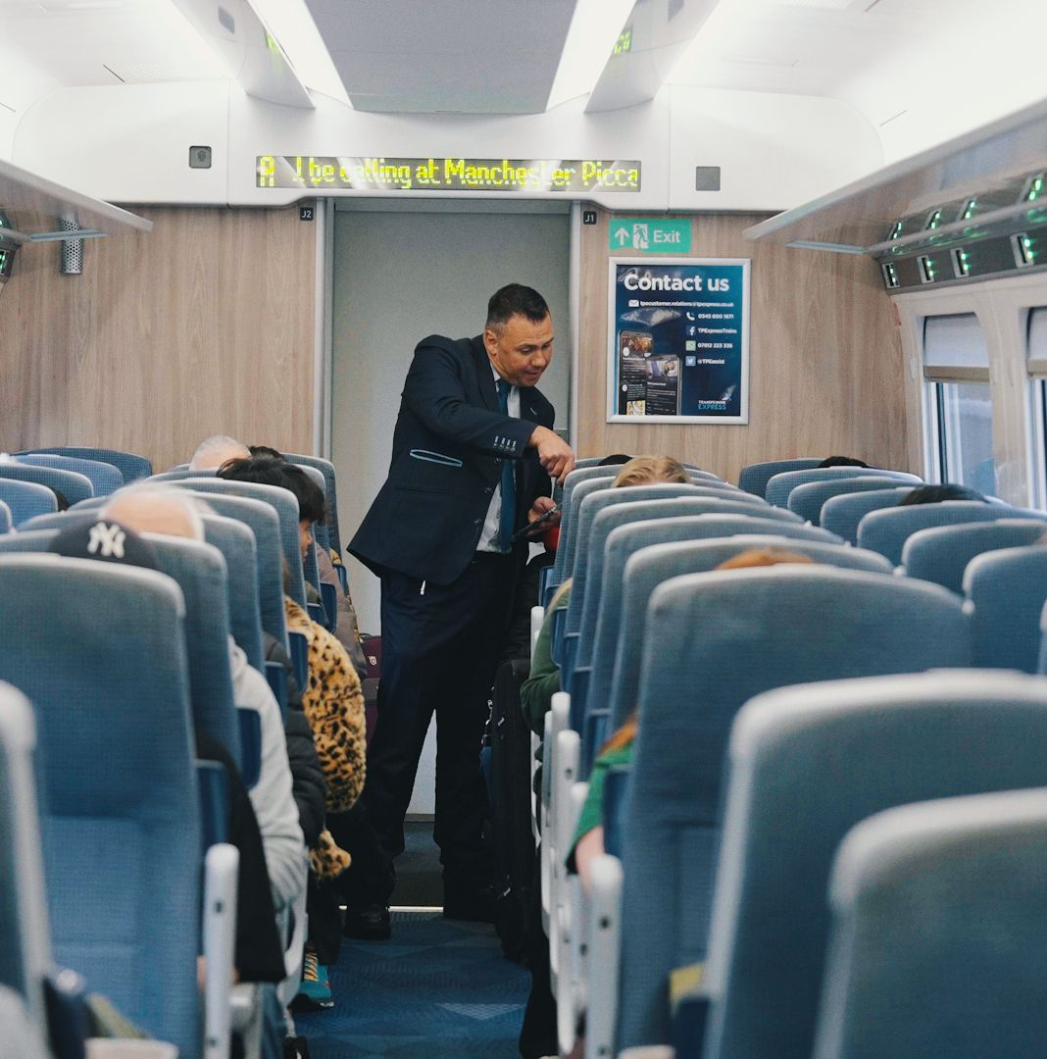
Discussion Points
On Board
The onboard environment is where customers spend most of their time. Possible discussion points include:
How can your actions on-board affect punctuality at each station and the overall service?
What actions can you take to manage your train effectively and support your team?
How does the onboard environment influence the passenger experience and the wider network?

Slide 24
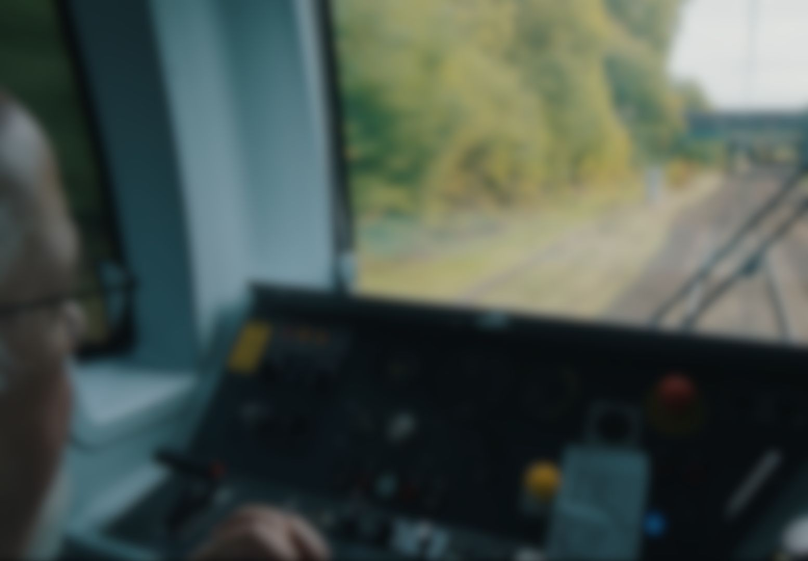
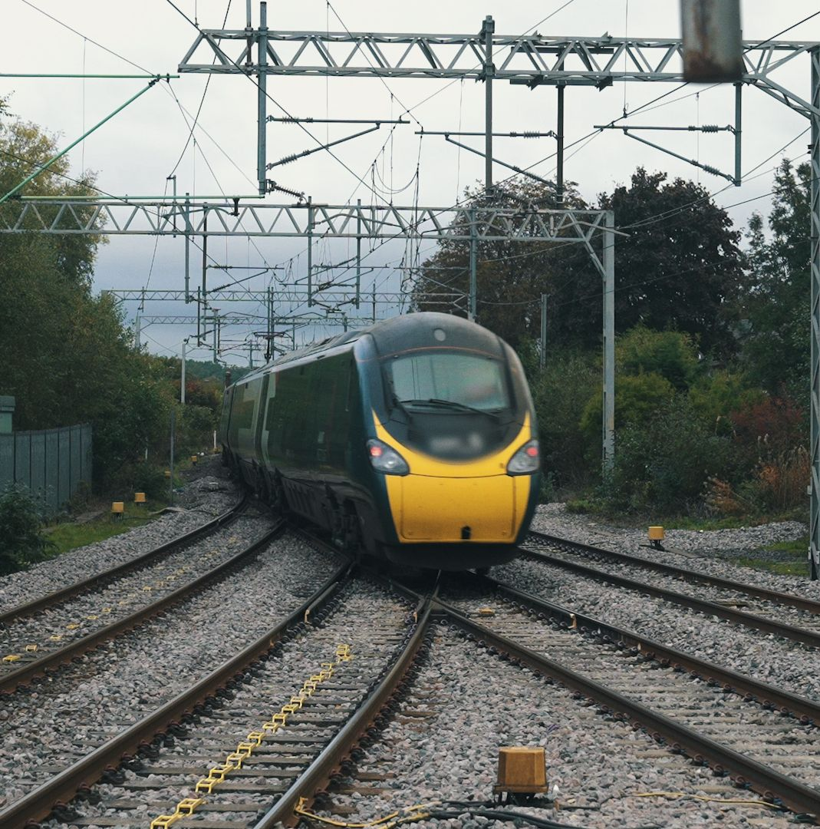
Discussion Points
Drivers
Running the train effectively is at the heart of a safe, punctual, and high-performing railway. Possible discussion points include:
How can you manage your train to assist in its punctual running whilst ensuring safety?
What pre-shift and on-train activities can make you better prepared to perform effectively and respond to issues?
How can communication with colleagues, signallers, maintenance, and passengers or freight teams reduce delays and improve service?

Slide 25


Discussion Points
Signalling and Control
Signallers and controllers are crucial to keeping trains on time. Possible discussion points include:
How can we improve communication between operational teams?
What signalling or control practices can be used to help maintain on-time running throughout the network?
How can we prevent small delays from escalating into bigger issues?

Slide 26

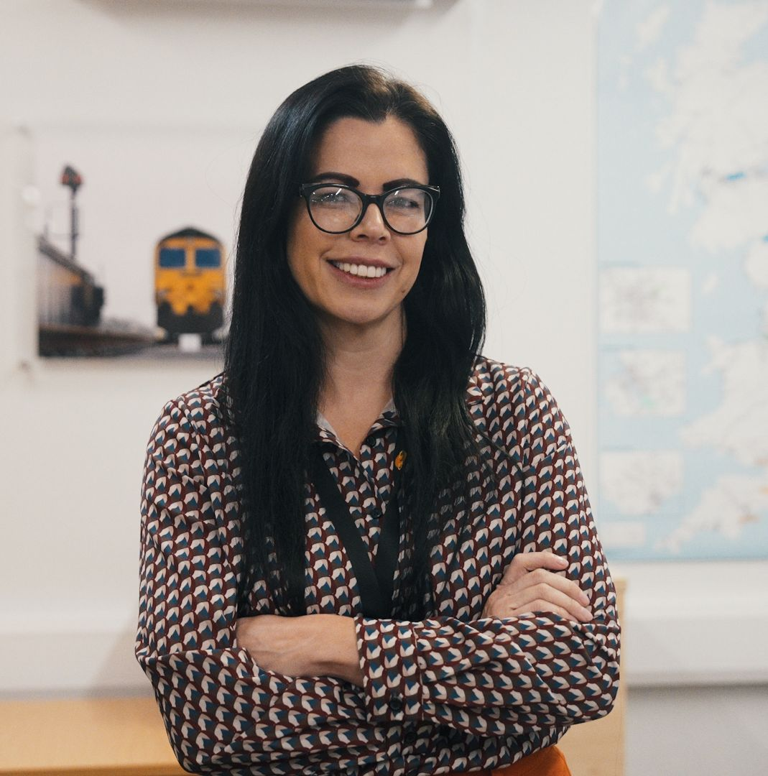
Discussion Points
Planning and Resourcing
Planning and resourcing shape how the railway operates every day. Possible discussion points include:
How can planning and resourcing decisions improve punctuality and recovery from delays?
What steps ensure the timetable meets customer needs while balancing efficiency and reliability?
How can planning teams and delivery functions work together to anticipate resource shortfalls and avoid repeat incidents?

Slide 27

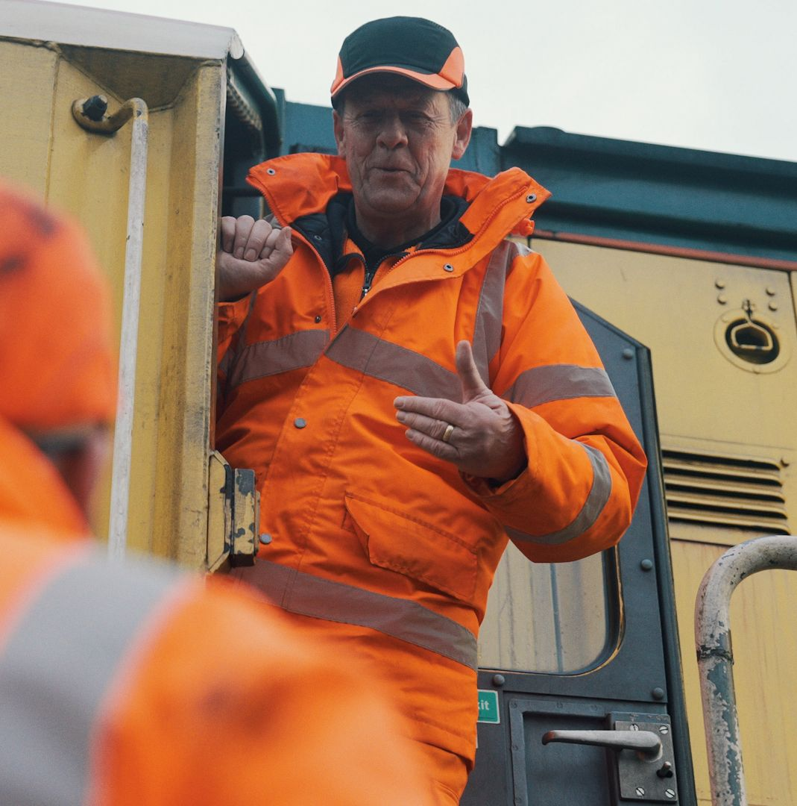
Discussion Points
Freight Operations
Getting goods delivered on time is crucial, and delays can ripple across the network and beyond. Possible discussion points:
How can effective communication between control, signallers, and traincrew minimise delays and prevent knock-on disruption?
What activities are critical to ensuring freight trains are prepared and maintained to meet tight schedules and integrated logistics requirements?
How can collaboration across operations, terminals, and fleet maintenance teams impact overall service reliability?

Slide 28
Delivering Excellent
Operational Performance
Briefing Materials Guide
www.example.com
example@email.com

