Slide 1

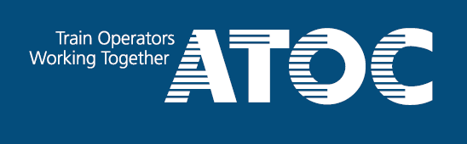
How can we encourage more private investment in Britain’s railways?
Tom Smith
Chairman, ATOC

Slide 2

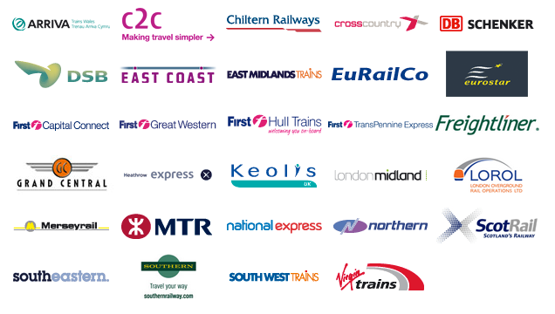
ATOC's mission is to work for passenger rail operators in serving customers and supporting a prosperous railway. Set up after privatisation in 1993, ATOC brings together all train companies to preserve and enhance the benefits for passengers of Britain’s national rail network.

Slide 3
The privatisation success story
Passenger numbers increased by 69%
Historically high levels of passenger satisfaction
Highest number of rail journeys since the 1920s
Demand forecast to double in 25 years

Slide 4

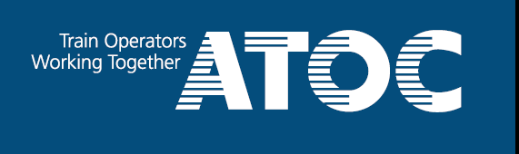
From a static to a dynamic national asset
Passenger journeys (millions) 1975-2011 – Source: ORR
Nationalised
Privatised

Slide 5
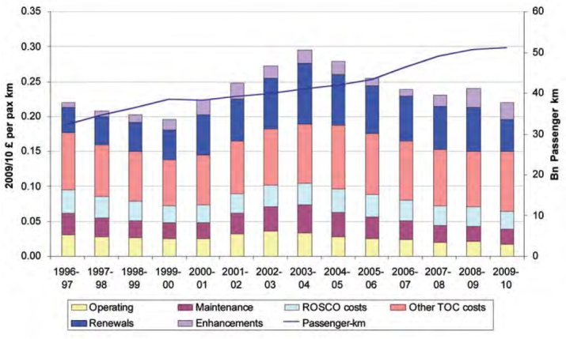

The McNulty challenge
Costs (£bn) per passenger km – Source: Fig 3.6 McNulty full report

Slide 6
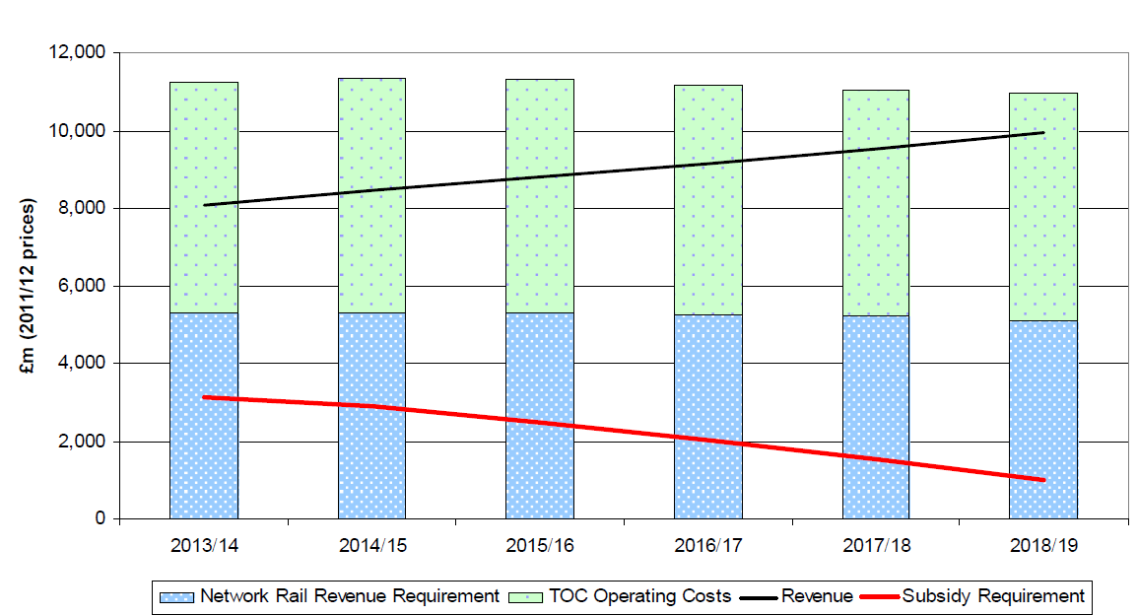
The Initial Industry Plan response
Costs, revenue and subsidy requirement, England & Wales to 2019
– Source: p7 IIP

Slide 7
How do we get there?
Franchise reform
Longer, smarter franchises, allowing the private sector to invest and innovate
Industry reform
Progressively transform Network Rail to create contestability and accountability with infrastructure provision
Targeted, sustained investment
Need to keep investing in network and train capacity as demand continues to grow
Smarter fares policy
More flexible approach to fund investment, reduce taxpayer support and make better use of capacity

Slide 8
Unlocking more private capital
Targeted, sustained investment
Need to keep investing in network and train capacity as demand continues to grow

Slide 9
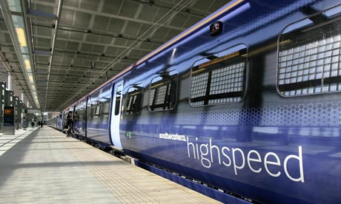


The good news
Long term nature of assets
Strong growth prospects
Weathering the downturn well
Railways have reasserted themselves as vital for the economy
Interested capital is there

Slide 10
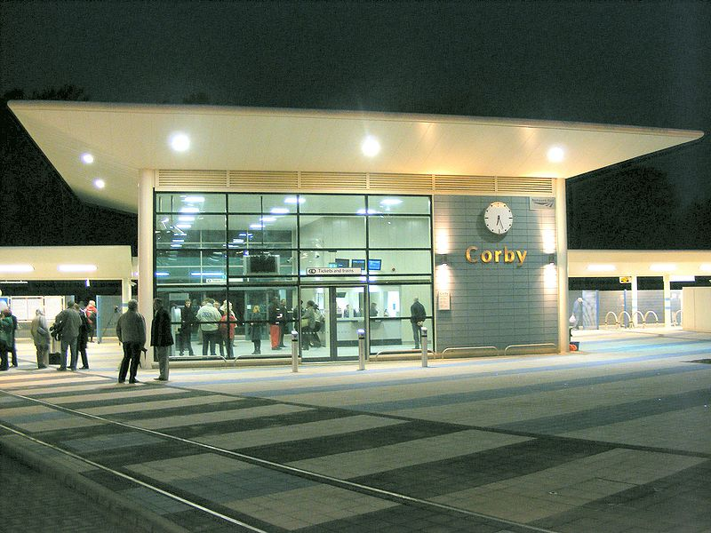
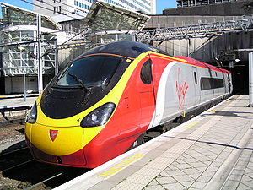
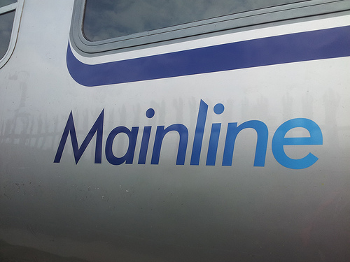
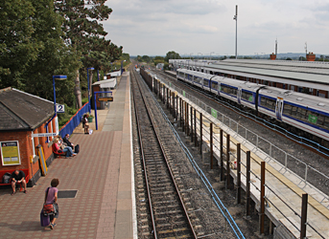
When it works, it works well
Many good examples of private sector leadership on the railways
New stations
New trains
New services
New track

Slide 11
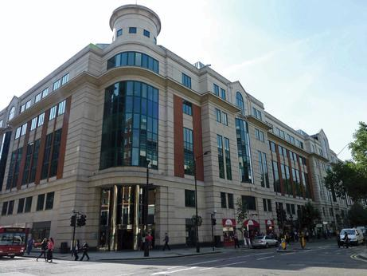
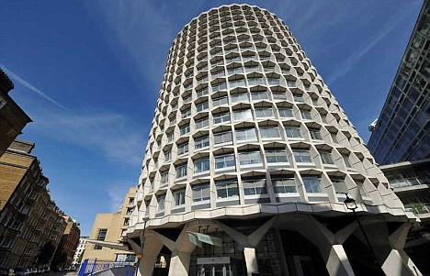
The bad news
Investors are wary of rail
Confidence low because franchises seen as short and unpredictable
Government seen as ambivalent:
  Wants innovation but unwilling to step back
  And seems confused about the idea of railways generating private profit

Slide 12
Total private sector investment (millions) in rail 2006-2011 (excluding Network Rail)
The outcome of this approach...
Source: ORR

Slide 13
Average age of rolling stock (yrs) 2000-2011
Private sector vs. government
Strategic Rail Authority
(procurement by TOCs)
Department for Transport
(procurement by govt)

Slide 14
Rolling stock proposals
More responsibility to TOCs
Industry to set an overall strategy
Government to set the strategic context (HLOS/SOFA) and use guarantees only where they might offer better value
ROSCOs to offer more flexibility on lease terms and maintenance arrangements
Holistic industry approach to rolling stock, embracing depot strategy, standardisation and supplier relationships

Slide 15
Conclusions
We need to reverse the trend
Rail should be a magnet for private investment
Current industry reform agenda gives us the opportunity
Government needs to set the tone
Investors must respond

Slide 16
How can we encourage more private investment in Britain’s railways?
Tom Smith
tom.smith@atoc.org
Chairman, ATOC

