Slide 1
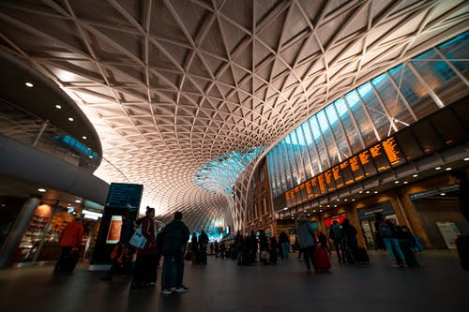
A new platform for regeneration
Amanda Clack
Executive Director Head of Strategic Advisory Head of Public Sector
21st September 2021

Slide 2
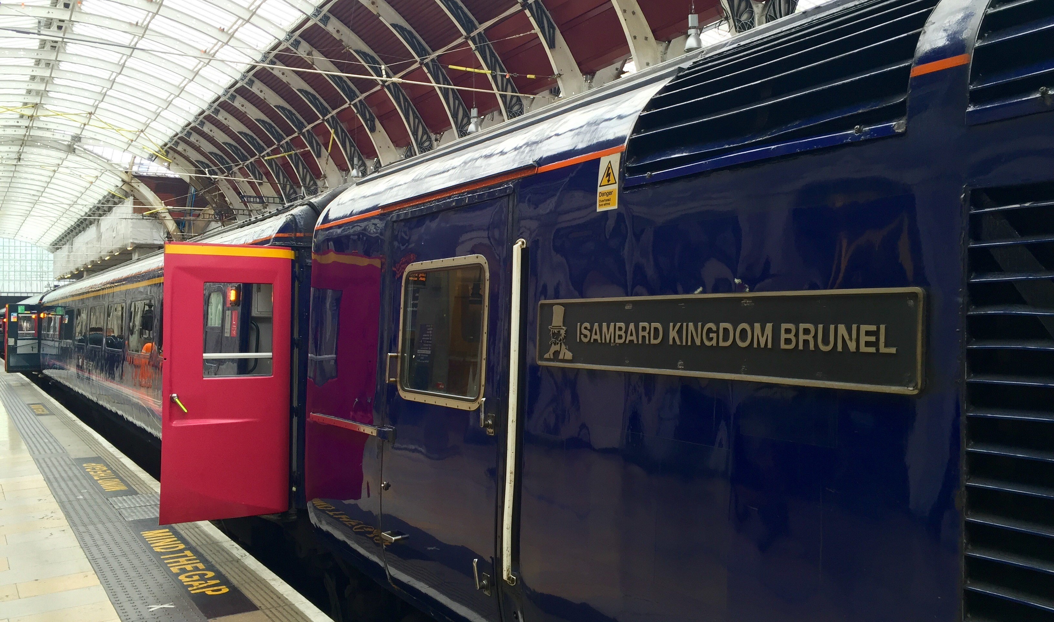
Outline
1 Introduction and the 4 P’s
2 The value in investing in stations
3 The station investment process
4 Attractiveness for investors
5 Realising the potential
6 Creating the vision

Slide 3
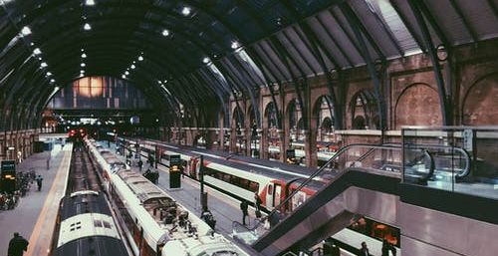
Introduction
1

Slide 4
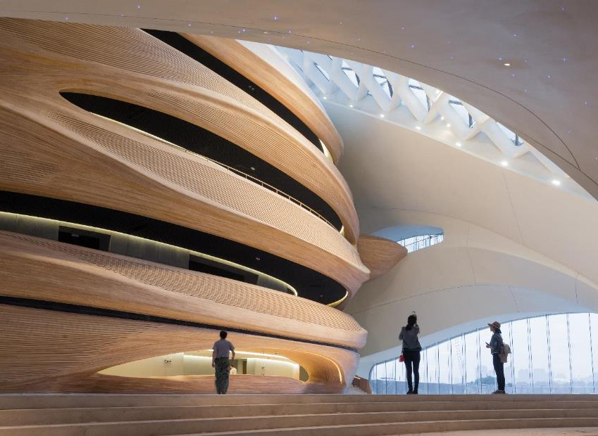
Stations offer the ability to act as a catalyst for regenerative growth and ambition
The 4 P’s:
People, Place, Property and Planet

Slide 5

The value in investing in stations
2

Slide 6
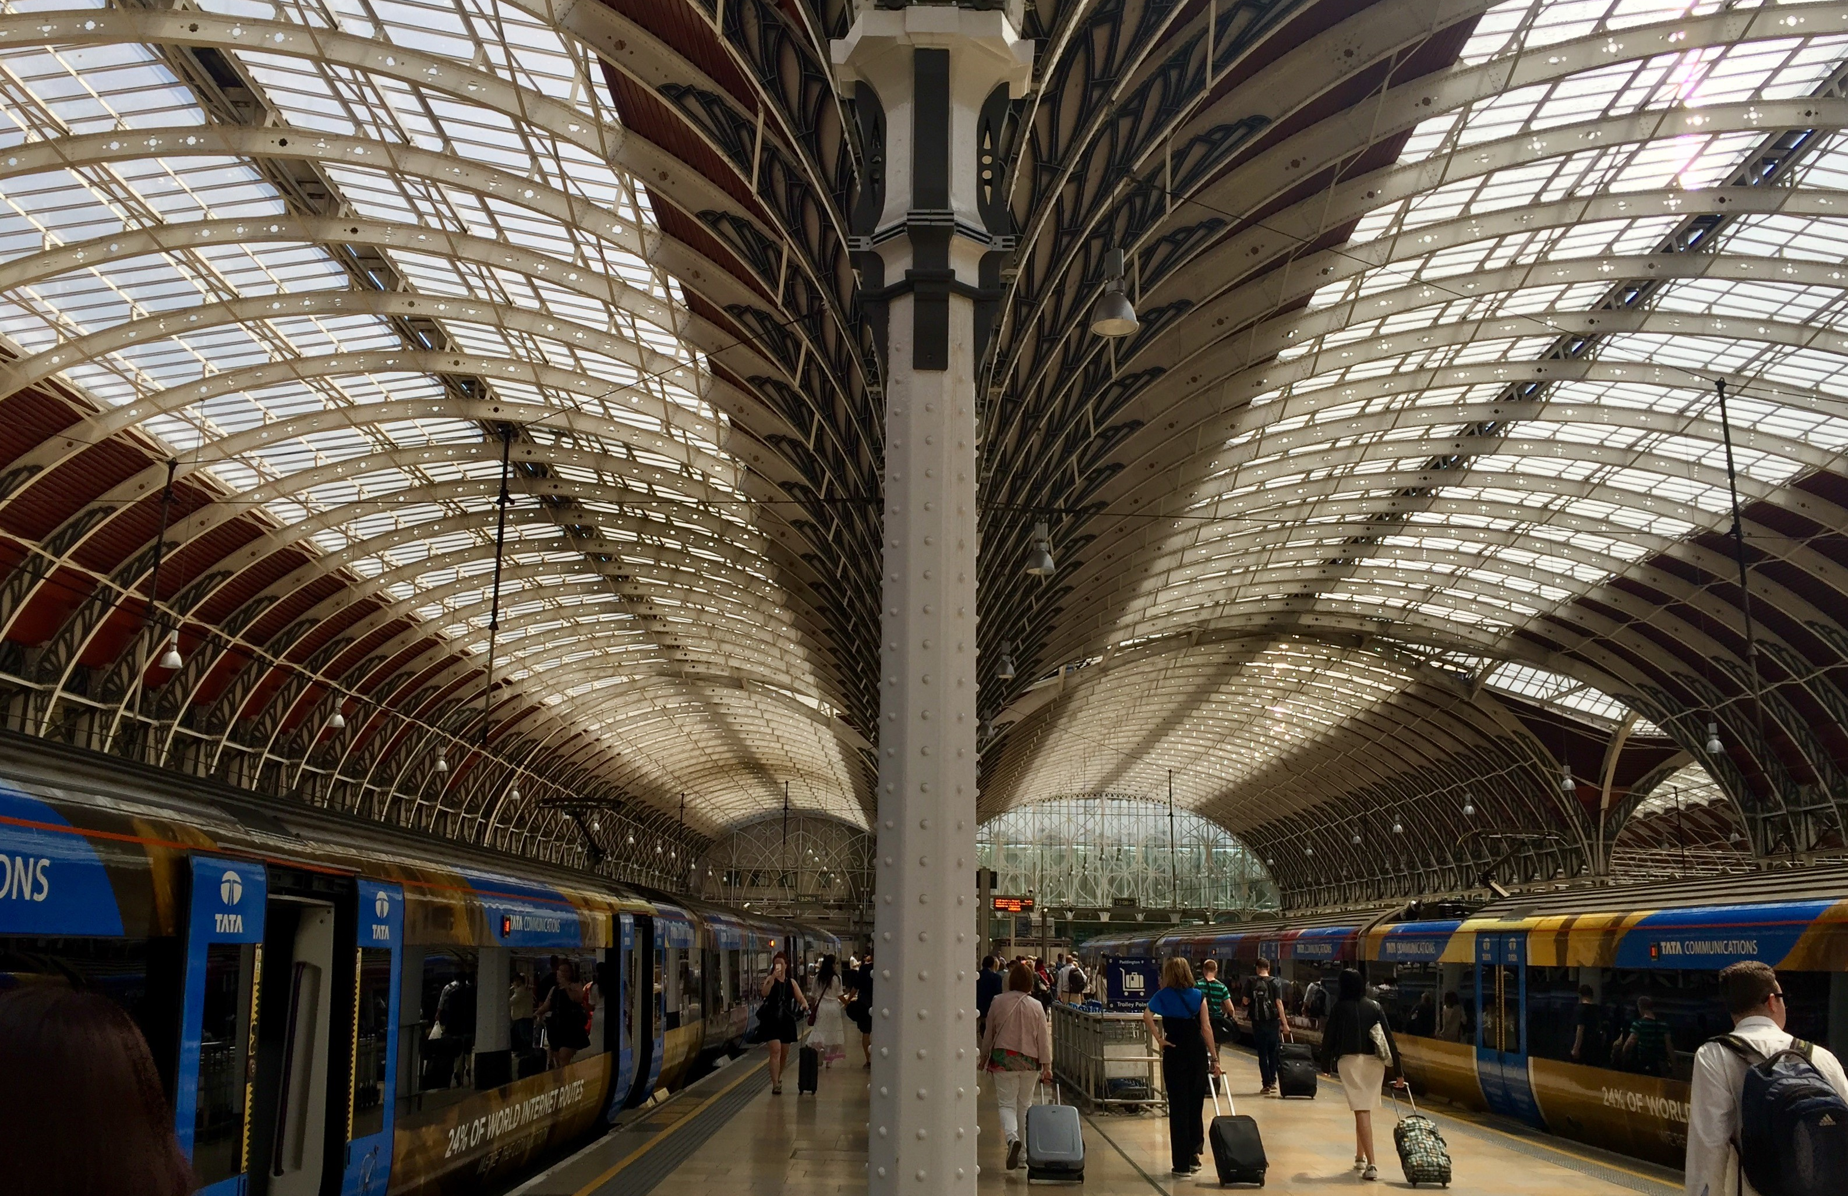
Key benefits: Operational, Facilities, Experience and Access Improvements.

Slide 7
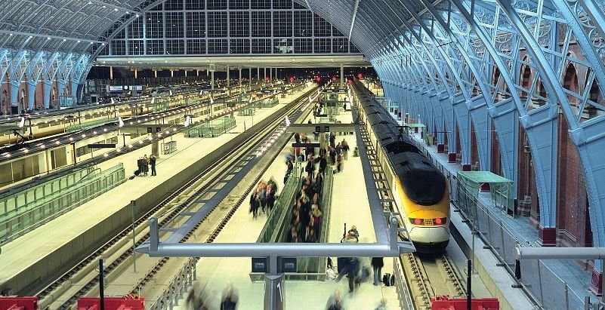
The station investment process
3

Slide 8

1. Identification and need for project development;
2. Funding and financing; and
3. Procurement and delivery.

Slide 9
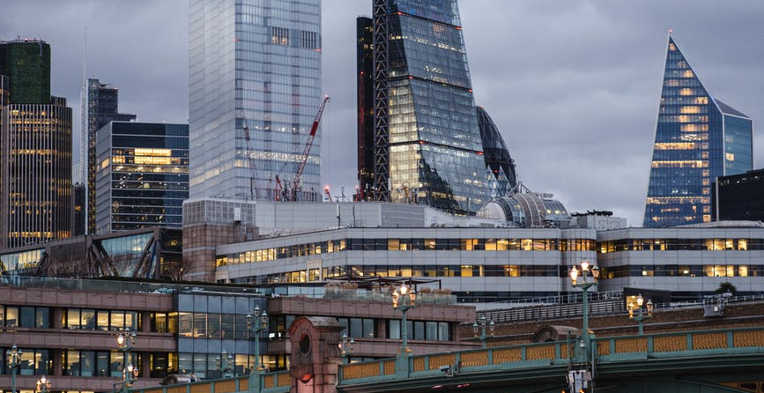
Attractiveness for investors
4

Slide 10
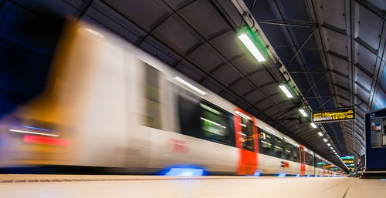
Realising the potential
5

Slide 11
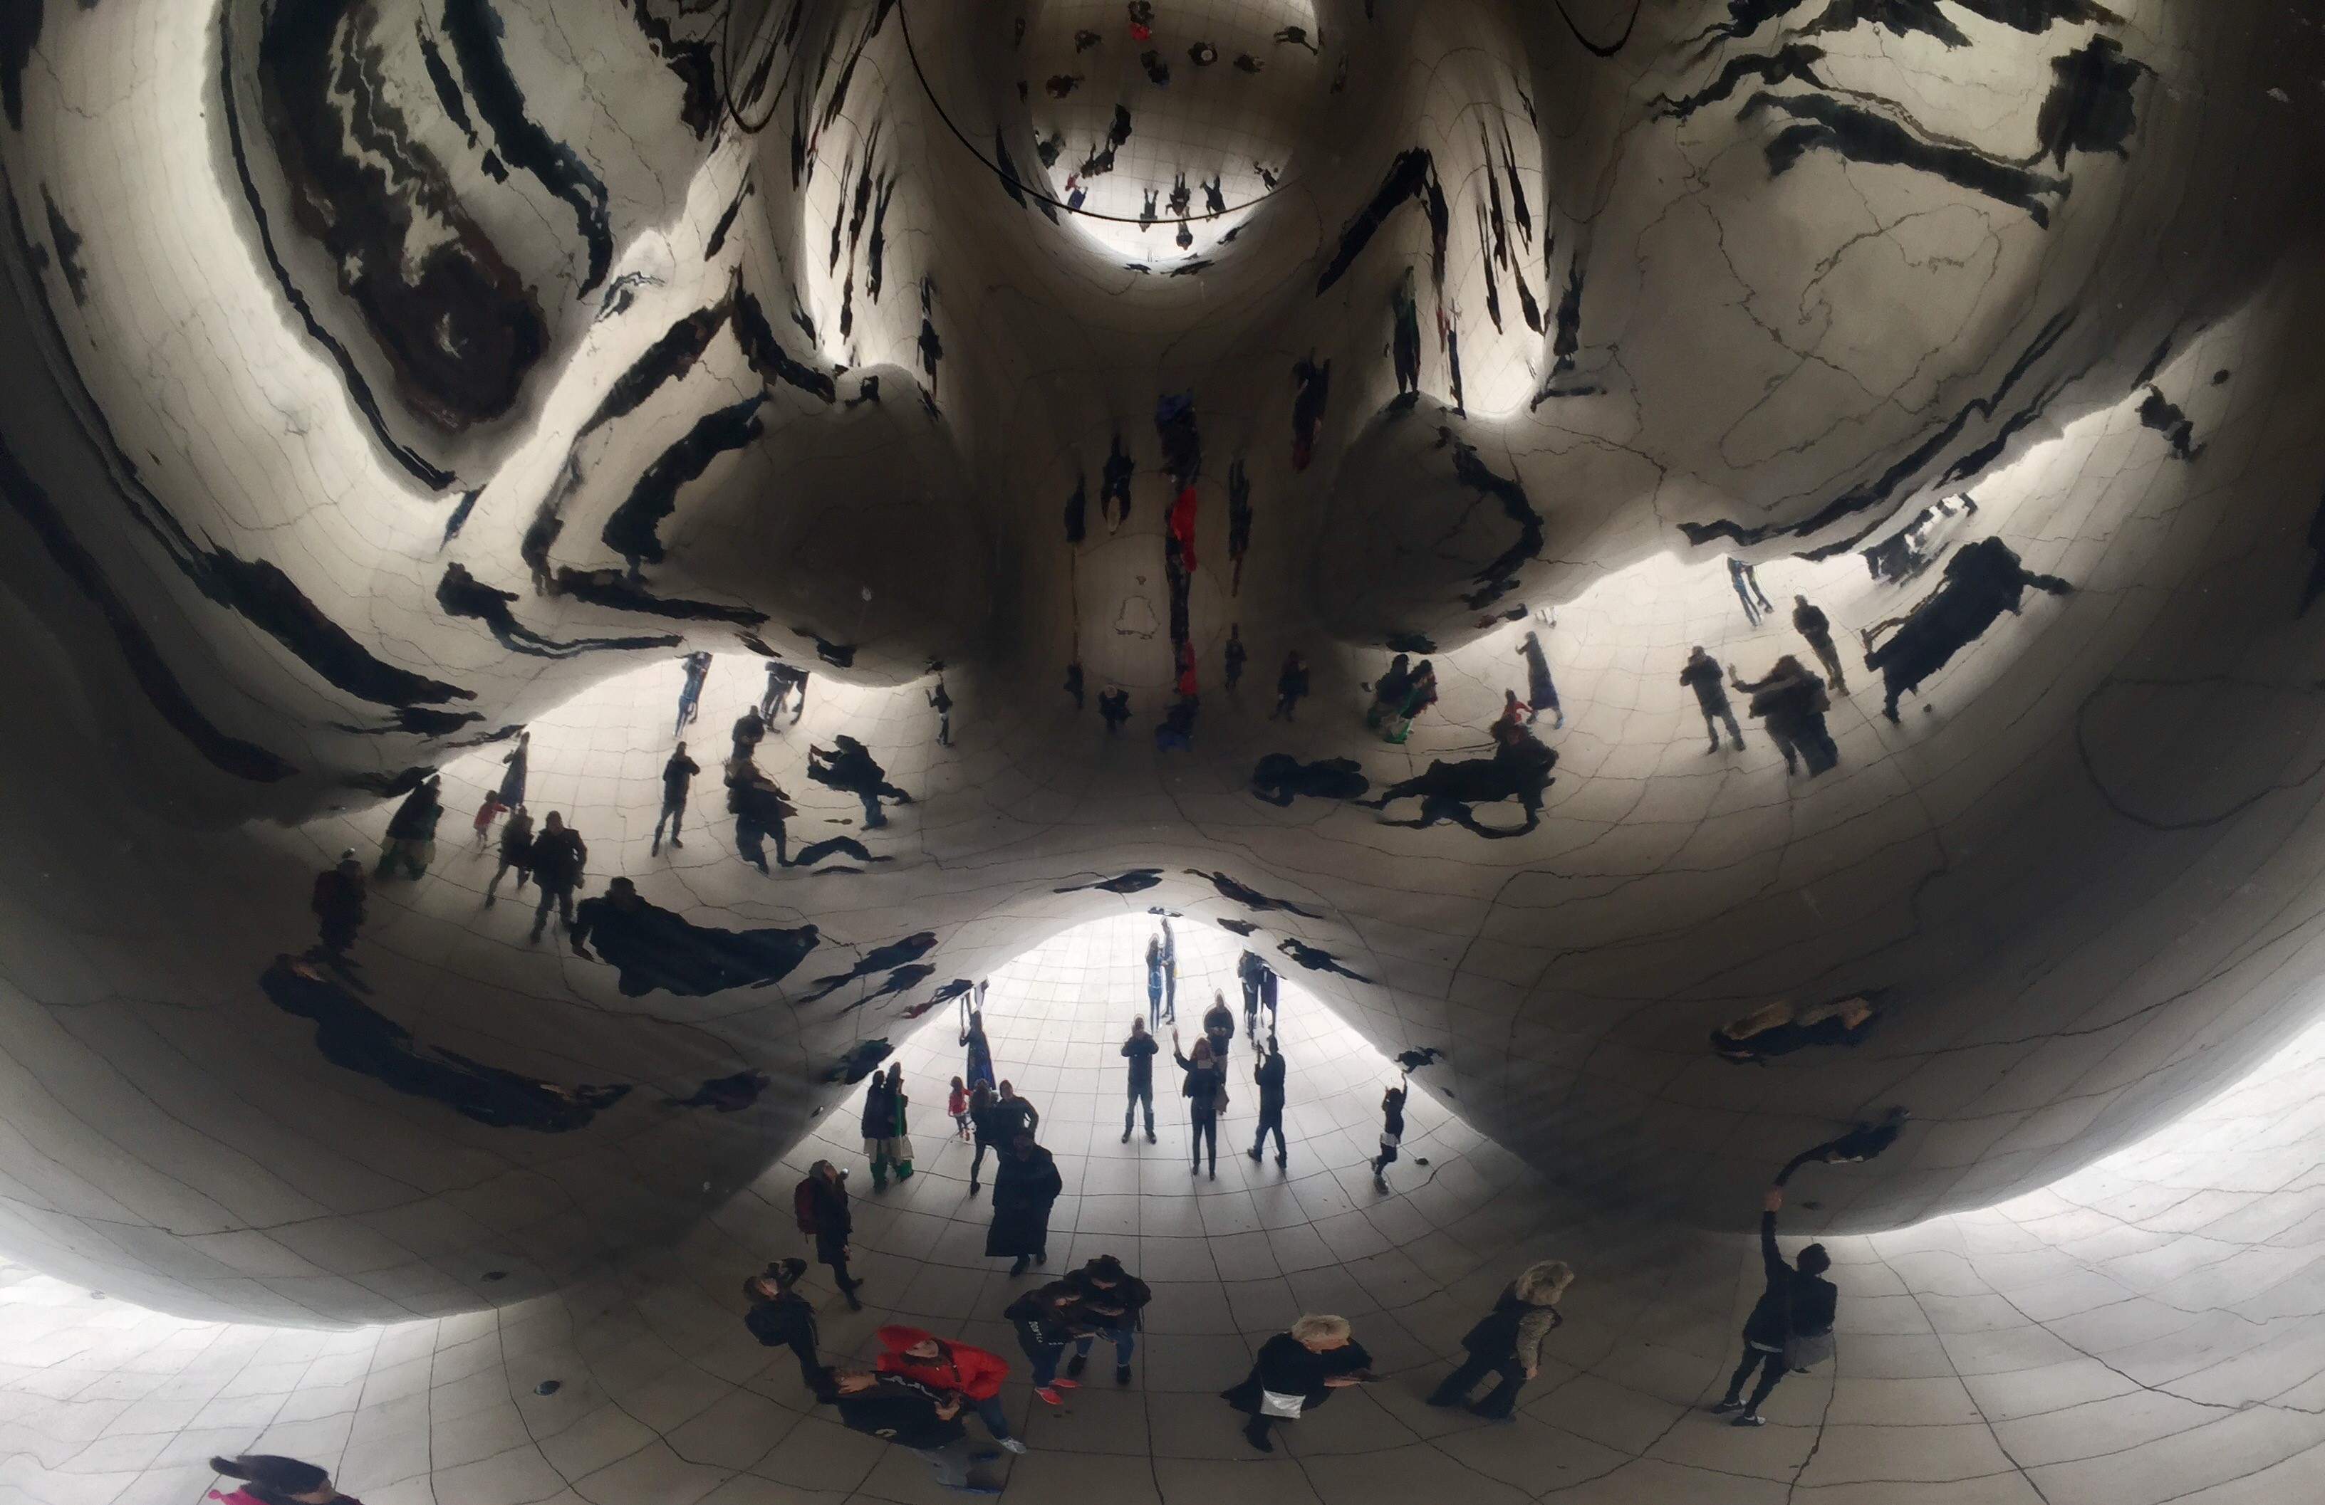
People

Slide 12
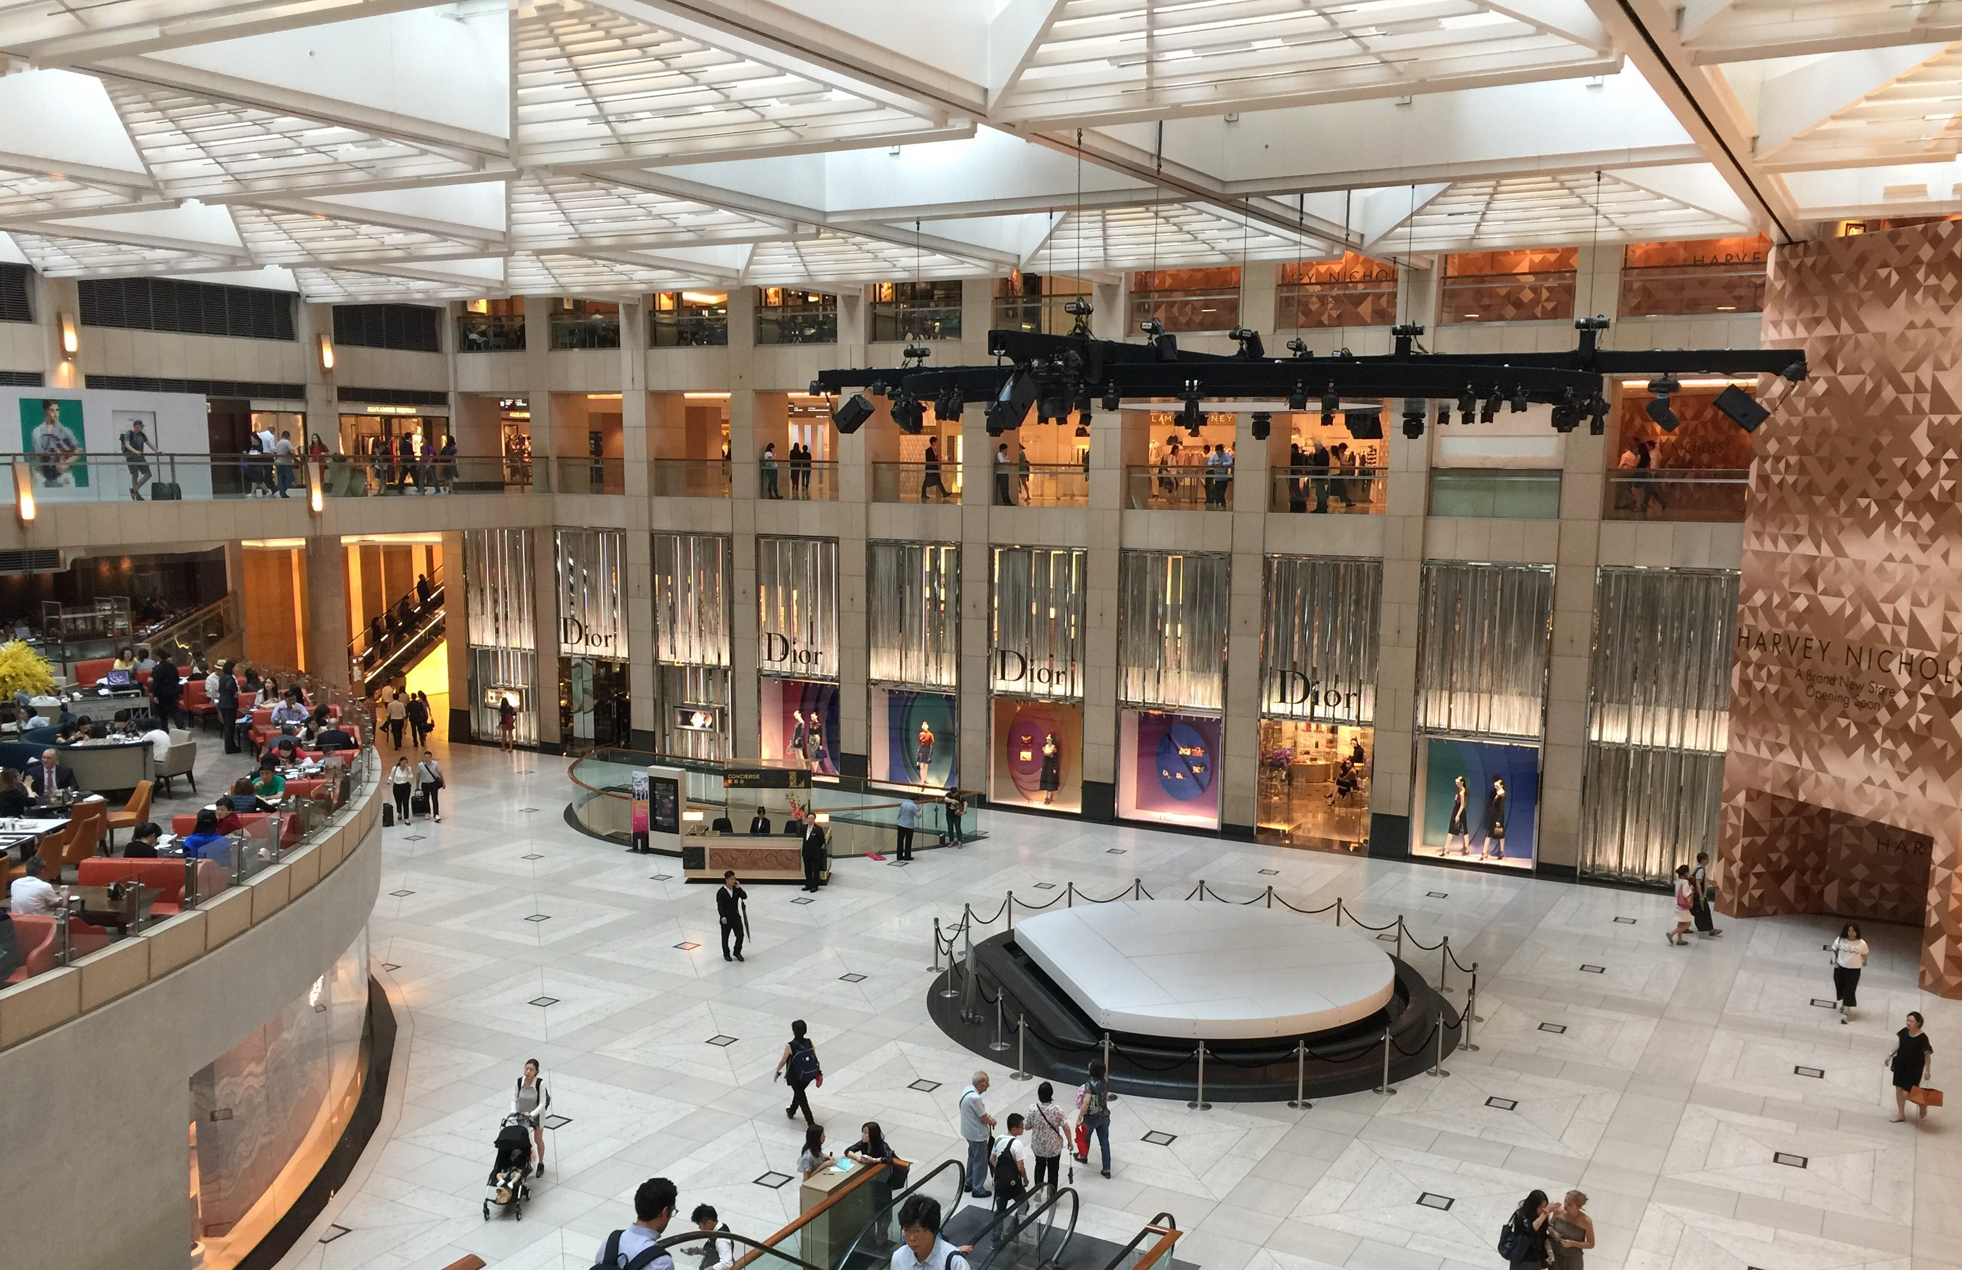
Place

Slide 13

Property

Slide 14
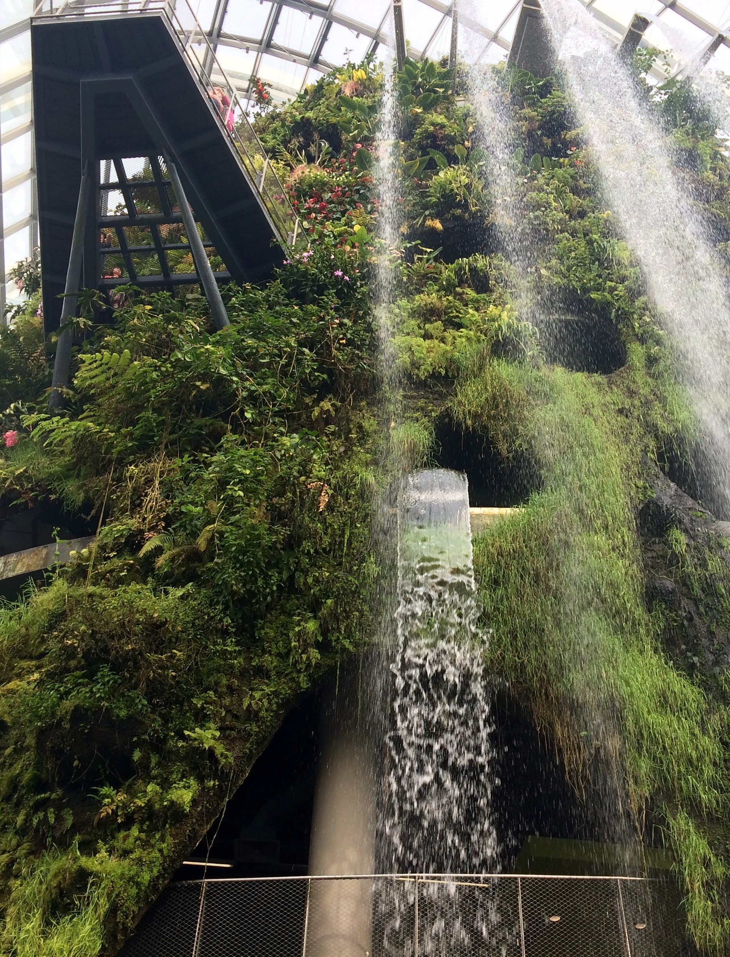
Planet

Slide 15
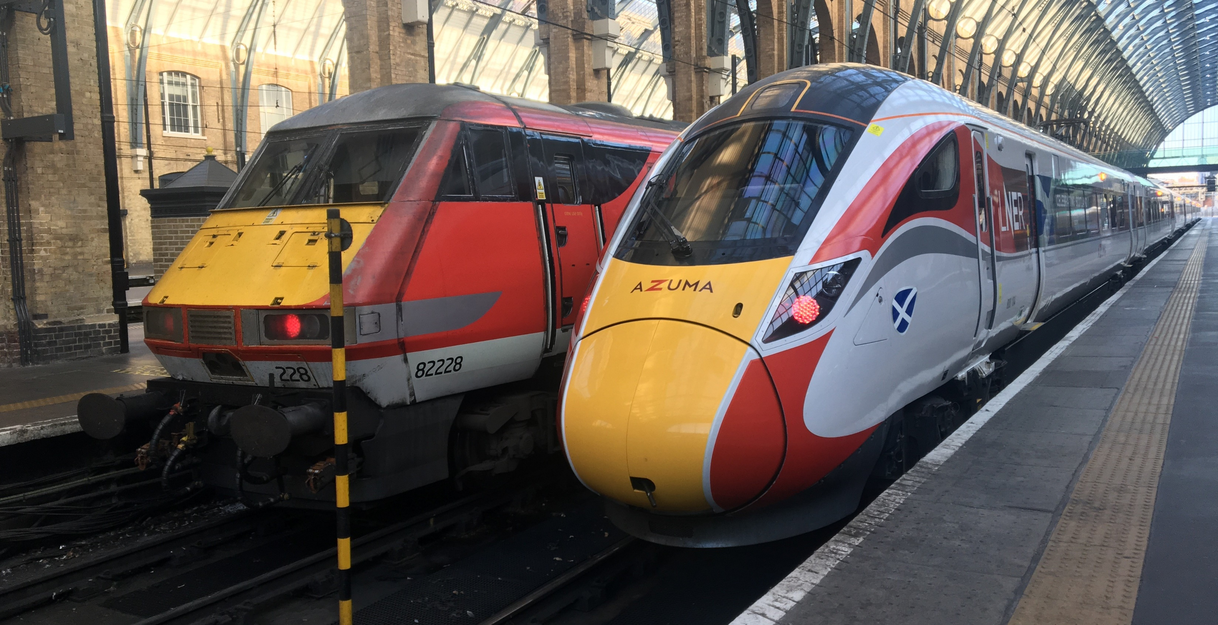
Creating the vision
6

Slide 16
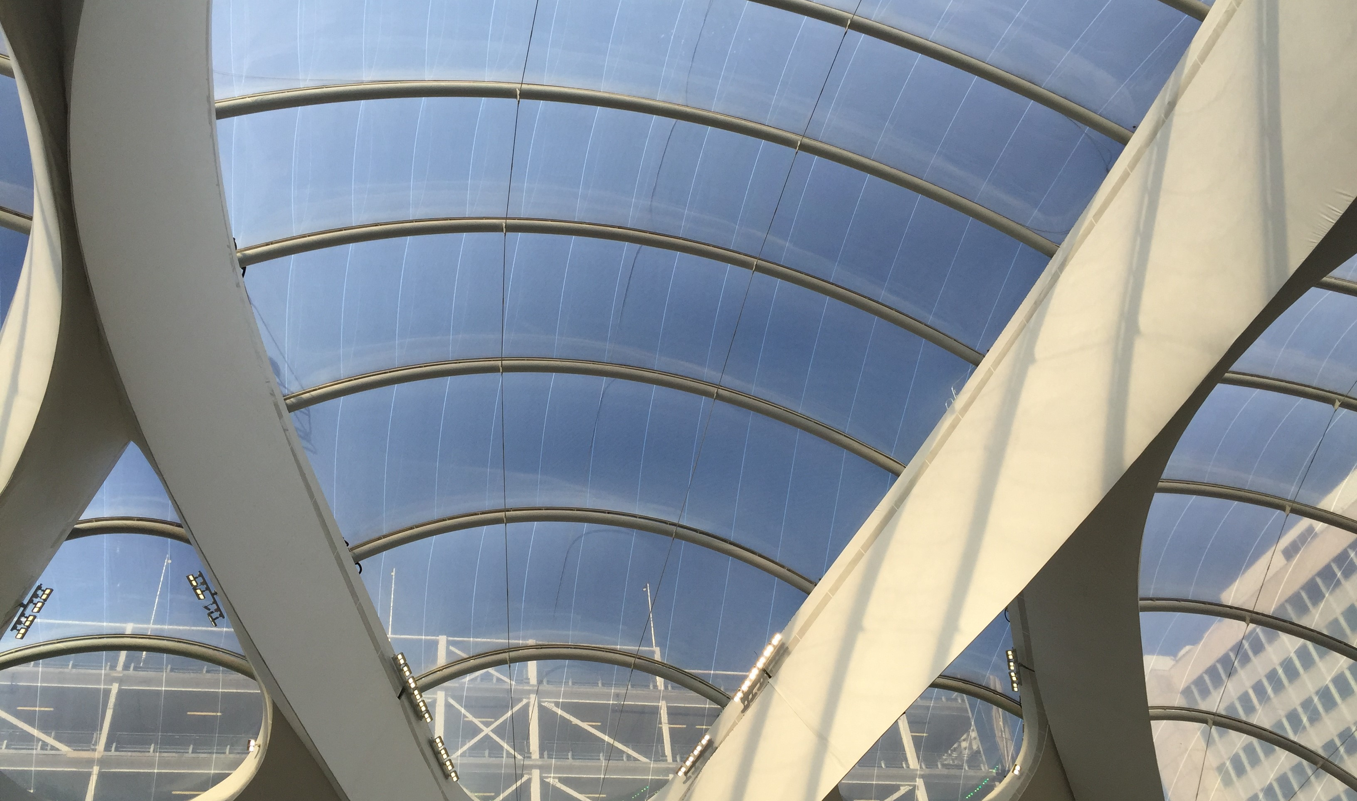
Amanda Clack
amanda.clack@cbre.com
Mobile: 07976 403438
Twitter: @Amanda_Clack

