Slide 1
Inclusion Innovation in Stations
Daisy Chapman-Chamberlain
Rail Knowledge Transfer Manager
Notes:
Hello. I’m Daisy Chapman-Chamberlain, the rail knowledge transfer manager at KTN.

Slide 2

KTN exists to connect innovators with new partners and new opportunities beyond their existing thinking - accelerating ambitious ideas into real-world solutions.
We increase access to new markets through our contacts and networks, work alongside government and private agencies to promote innovative solutions and assist SMEs and companies in accessing funding and development opportunities through guidance, contacts and support.
Notes:
Within my work at KTN, I provide innovation and funding stream support to companies within the rail sector - alongside key rail stakeholders and academics – building on delivery of key regional and national strategies.
I also lead on Accessible & Inclusive Mobility across transport modes, I am the Vice Chair of ITS UK's Inclusive Mobility Forum and a Board member for the Association of Community Rail Partnerships.

Slide 3
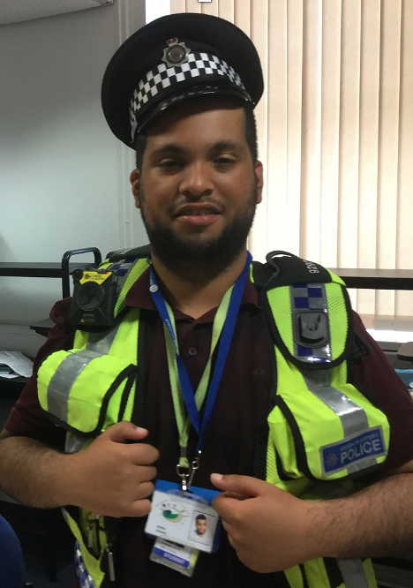
What can we do? In transport
COVID recovery inclusion
Physical access, step free access
Technology innovation (VR and AR, virtual tours, wayfinding, assistance schemes)
Information provision and innovations (in many forms, before, during and after a journey)
Digital access - for ticketing, websites and so on
Confidence for life – travel training – schools work
Community work – like Community Rail, dementia-friendly railway etc.
Changing Places and other needed facilities
Health - access in the widest sense for the future, anxiety and mental health needs as well as less-visible disability
Greening stations for the future and environmental considerations - the climate crisis for us all is the key thing that will shape our futures and we have to keep that in mind

Slide 4
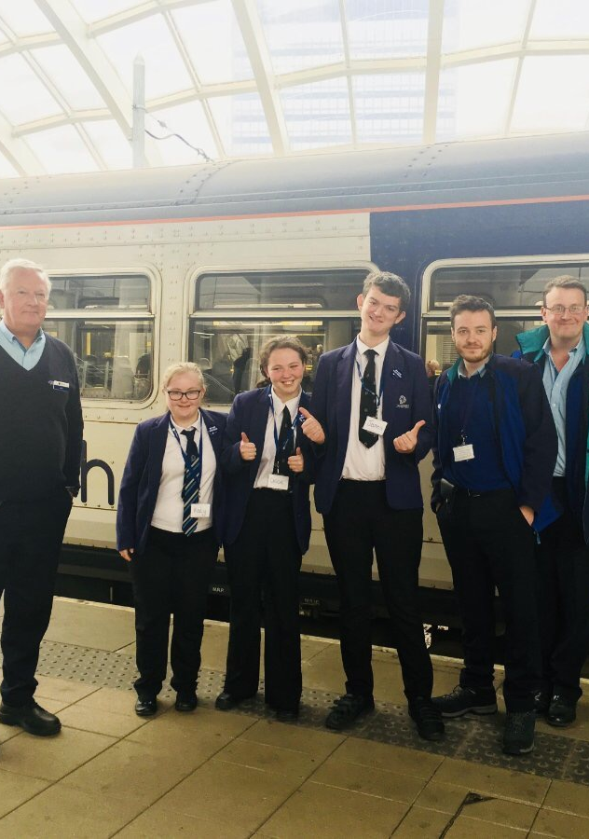
When developing tech, trains and any facility or service that customers or staff interact with, it’s crucial to focus on the human need within this. A system built without lived experience and consultation cannot serve all those it needs to or be inclusive.
Potential within rail and needs include information provision, tech using AR, staff training, signposting, lighting, strong visual contrasts, consideration of colours and pattern use, offering flexibility in terms of service/train used, physical accessibility, many different methods of information provision and more.
Layout of spaces, sound levels, lighting (especially reducing flickering) and consideration of colours and patterns.
There are clear needs within rail to better serve passengers with disabilities (as both disabled and non-disabled adults rely on car travel for around 3 in 5 trips for both groups) - including physical access needs, access for those with non-physical access requirements, and an urgent focus on tackling hate crime.
Notes:
I am going to pick out just a few of these today

Slide 5
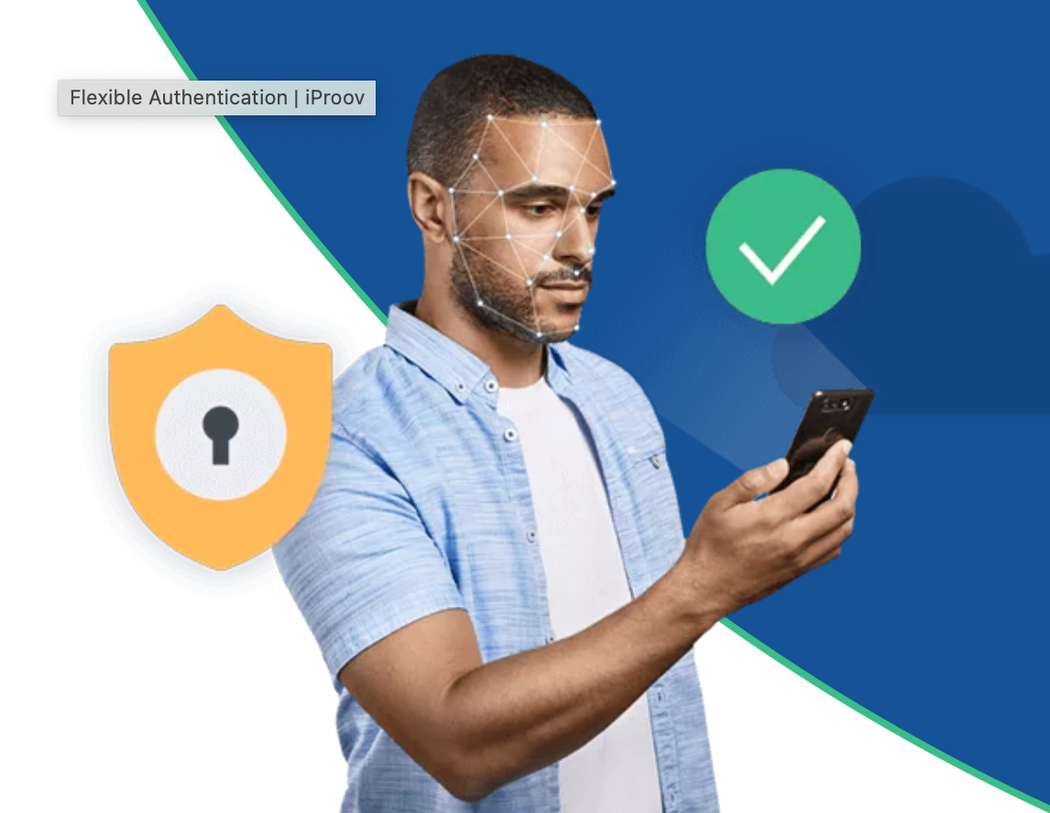
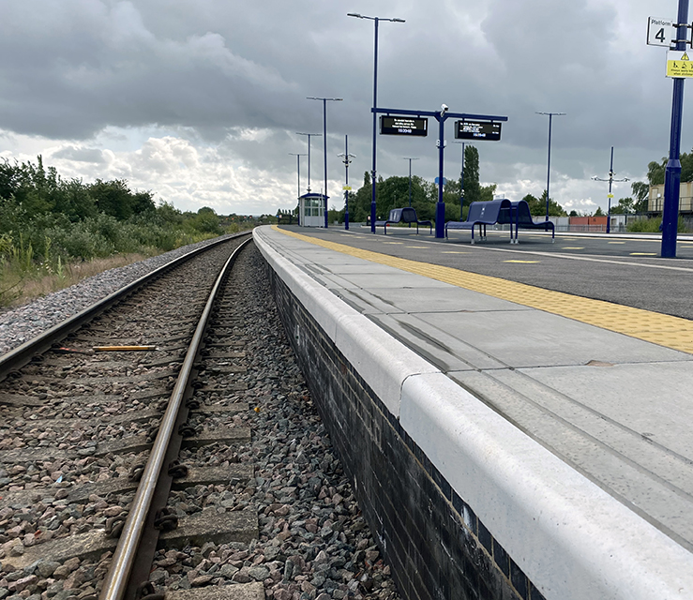
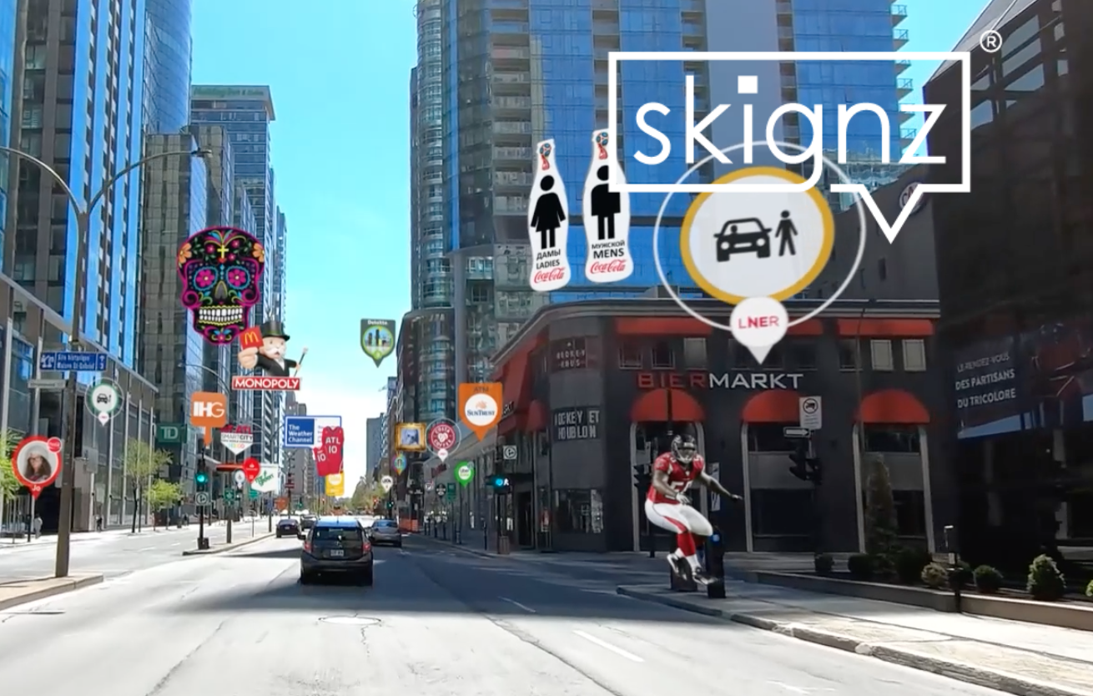
Innovation and innovation funding
Notes:
First of a kind is a yearly programme of funding of around £10m that launches demonstrators of innovations within rail – where companies and academics work in partnership with rail stakeholders and operators - to solve needs from sustainability to freight to accessibility. This programme harnesses the very best of creative, innovative development in the UK and gives it the funding needed to demonstrate and ideally move on to commercial success.
Three examples of this success within rail innovation are;
LAMINAR – Freeflow Admission to rail services using face verification - This project will demonstrate the world's first application of walk-through access to high-speed railway services, enabled by biometric verification. Integrating proven secure identity verification technology with the systems of an international rail operator, the project will demonstrate how opt-in, consent-based biometrics can dramatically enhance the passenger experience, reduce congestion, improve safety and enhance security. - Contactless Travel Entry for Eurostar as the first example – improving ease of travel for all and reducing journey stress
**skignz** provides '_Precise Location Augmented Reality'_ (PLAR) that allows _'Rail Operators'_ and their partners to deliver interactive branded digital content in and around every station across the UK.
Emerging from the current pandemic, the **skignz** PLAR technology will be used for passengers, staff and contractors to improve, enhance and improve the seamless flow through our stations.
The **skignz** PLAR technology is real time, hyper accurate and can be managed either by the rail operators or through multiple data feeds pushing out live information to multiple locations and individuals. By providing a seamless link between the _'physical'_ and _'digital'_ worlds, the ability to reduce passenger anxiety, physical touchpoints, provide real time information to their fingertips. Key areas of focus for this particular project will include:
**- Wayfinding** - Removing the reliance on Maps, providing real time travel & public information to each passenger, meeting their specific needs at that moment! Coffee? Toilets? Taxi? Member of staff? All are clearly identified, segmented for ease and allows the passenger to curate their own journey in and around the station environment. In addition this presents commercial revenue opportunities with existing partners
**- Assisted Travel -** A unique way to support and enhance the experience of passengers with special/assisted needs. Immediate response through real time selection, allowing staff to respond quicker, regardless of the location of the passenger within the station. Ultimately allowing the _'assisted passenger'_ increased independence, enhanced experience and an overall improved journey
**- Personalised Travel** - Placing the information at the fingertips of the passenger in a clear and concise way, enabling them to enter the station and seamlessly find where they need to stand in order to get on their specific carriage and platform. This approach will help reduce anxiety for passengers, whilst freeing up time for station staff
**- End to End Travel** - Identifying modes of transport to/from stations regardless of the passengers varying requirements for each journey, essentially connecting the trains to all other modes of transport for a smooth journey from door to door
Illumin-heated concrete platform slabs – making station environments safer for all, including those with mobility needs
- The aim of the project is to develop illuminated and heated (‘Illumin-heated”) concrete slabs for railway platform copers enabling automated de-icing during winter periods and dynamic wayfinding for alighting or boarding passengers. The project is unique in that it will incorporate a low energy heating element embedded into the concrete coper on external platforms and with the use of thermostats will automatically switch-on at freezing temperatures. During wet conditions, the heating can also be applied leading to a quicker drying of the coper. The illumination will be integrated into the top of the slab and will direct alighting passengers to the exit and guide boarding passengers to the correct part of the platform.

Slide 6
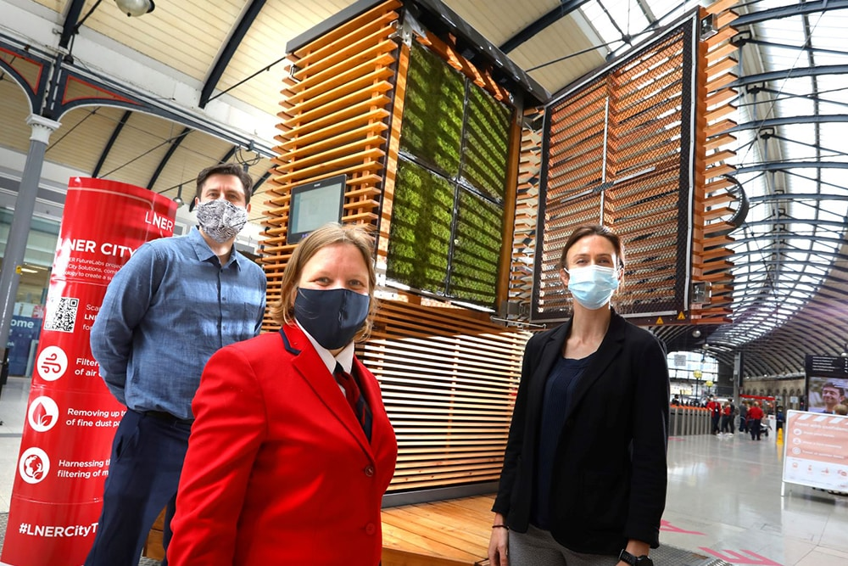
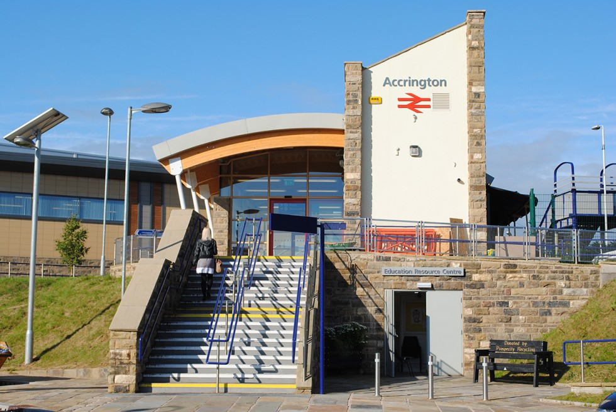
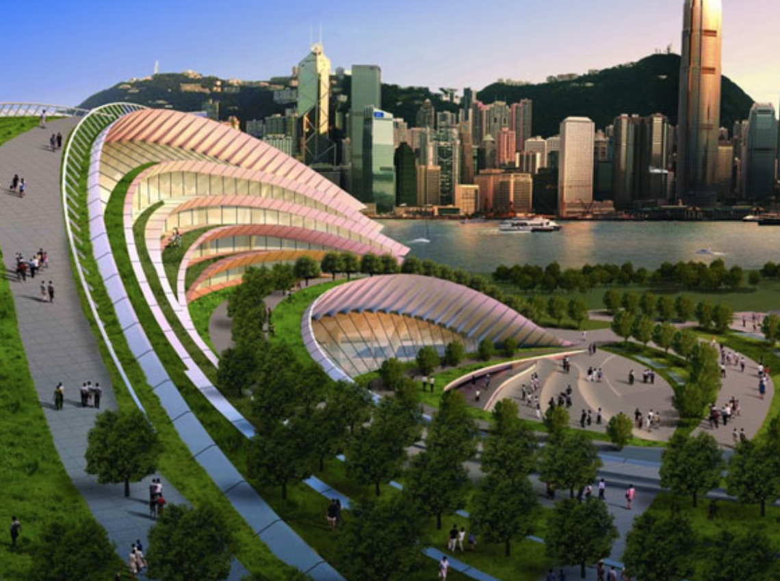
Greening stations
Notes:
Environmental considerations are a key part of inclusion;
Greener spaces reduce anxiety and stress and can make It easier to be in a space
Greener spaces improve air quality which can help anyone with a breathing need or other
Wider, open spaces improve public health – as proven during COVID
As well as the overall impact on global climate change as a larger piece
The City Tree - Combining the ability of living moss to bind fine dust and remove it from the air, with cutting edge technology, the CityTree has been designed to clean, cool and humidify 3,500 m³ of air each hour. That is equivalent to the breathing volume of 7,000 people.
Newcastle Central Station is the first station in the world to benefit from having a CityTree inside, as a result of LNER’s innovation programme, LNER FutureLabs, which fast tracks new and emerging technology into the rail industry.
Accrington train station – part funded by the EU through the Interreg IVB programme in 2010 was the first of its kind on the UK’s northern rail network, received a BREEAM rating of ‘excellent’ at the beginning of December 2010.
The building is made from recycled stone and uses photovoltaic cells to provide some of the building’s electricity requirements, incorporates solar water heating, a wind turbine for electricity generation and rain water harvesting for flushing toilets. Thirty photovoltaic solar panels, which it is hoped will supply over 4,000kWh of electricity – help reduce carbon emissions from the new station.
And for blue- or green sky thinking – the Express Link West Kowloon Terminus is a new rail station slated for Hong Kong – designed with green, open space in mind

Slide 7
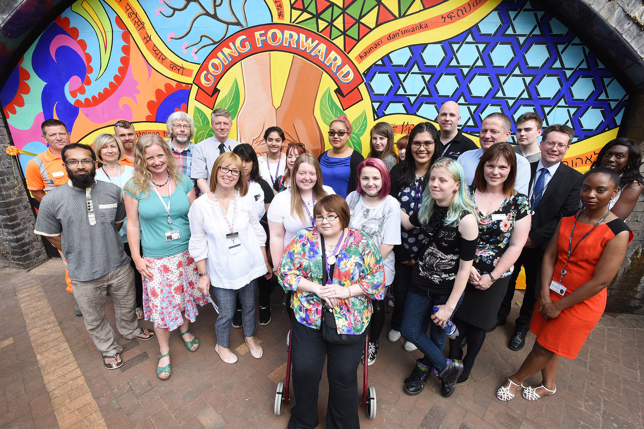
Community Rail
Around 8,500 volunteers (2019) give more than 390,000 hours every year to delivering community rail activity, on initiatives including community gardening, station maintenance, events, schools’ engagement, walking and cycling activities, and accessibility programmes. This activity is calculated to be worth £5.6m annually in terms of their labour contribution, plus anything up to £27.6m in social value to community rail volunteers themselves.
Community rail lines – those with community rail partnerships – performed well in terms of passenger numbers, which might be attributed partly to work by community rail groups. A sample group of 36 lines showed a 42% increase in ridership between 2008/9 and 2017/18, higher than the total overall increase in passenger journeys of 35%.
Seedcorn and small-scale grants to these partnerships and station adopters are turned into incredible, locally-linked stations projects and installations; from art to accessibility, reducing vandalism and increasing customer satisfaction.
Notes:
The ‘Rail Journey to Recovery’ is an innovative project between Community Rail Cumbria and Turning Point, a national charity specialising in the rehabilitation of people with substance and alcohol abuse issues.
The project integrates station-based activity like gardening and cleaning within established programmes of rehabilitation, focusing on enhancing participant’s self-esteem, social interaction and confidence.
Smethwick Rolfe Street is an inner-city station near Birmingham, opened in 1852, in one of the most diverse parts of the West Midlands, with a vibrant cultural mix. Sister station Galton Bridge, opened in 1995, is a mile away, fully accessible and with a footfall of 0.64 million (one third more than Rolfe Street). Rolfe Street station staff are passionate about their historic station and felt it was being left behind the newer Galton Bridge. They wanted to make it more welcoming to the diverse community and encourage its use by involving the community in improvements. This includes a regenerated garden and station building with a new station history and community exhibition space.

Slide 8
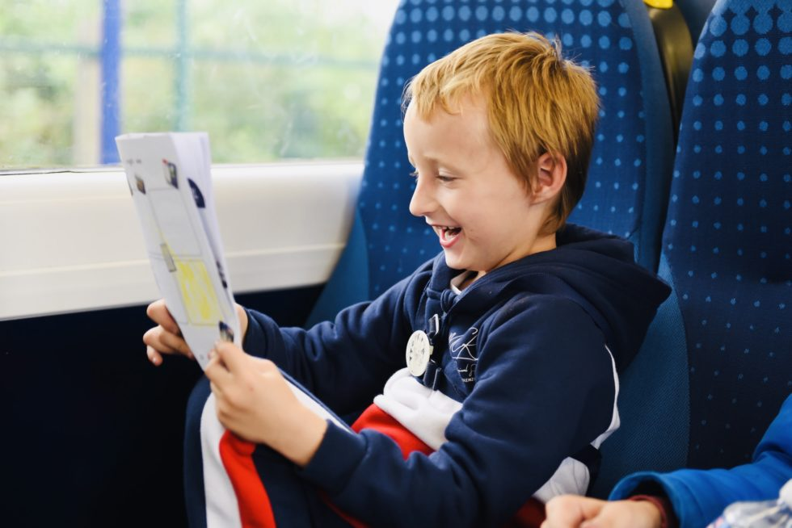
Case Study
Autism Friendly Railway Line
UK
Community Rail Lancashire, in partnership with Northern and working with the National Autistic Society launched the UK’s first autism friendly railway line. Autistic people can struggle in public places like in stations and on trains and be anxious about unexpected changes, like delays on transport. The National Autistic Society trained Northern staff members working on the line about how they can deliver the best possible experience and support for autistic customers and others with less-visible needs. There are also specialist resources available including sunglasses and ear defenders to assist passengers who may have sensory needs (subject to availability) and detailed line guides for families to download and help them prepare for their journey. The guides cover key travel information about the stations, trains and family-friendly businesses along the line, many of whom have autism-friendly sessions. Activity books are available for young adults and children.

Slide 9
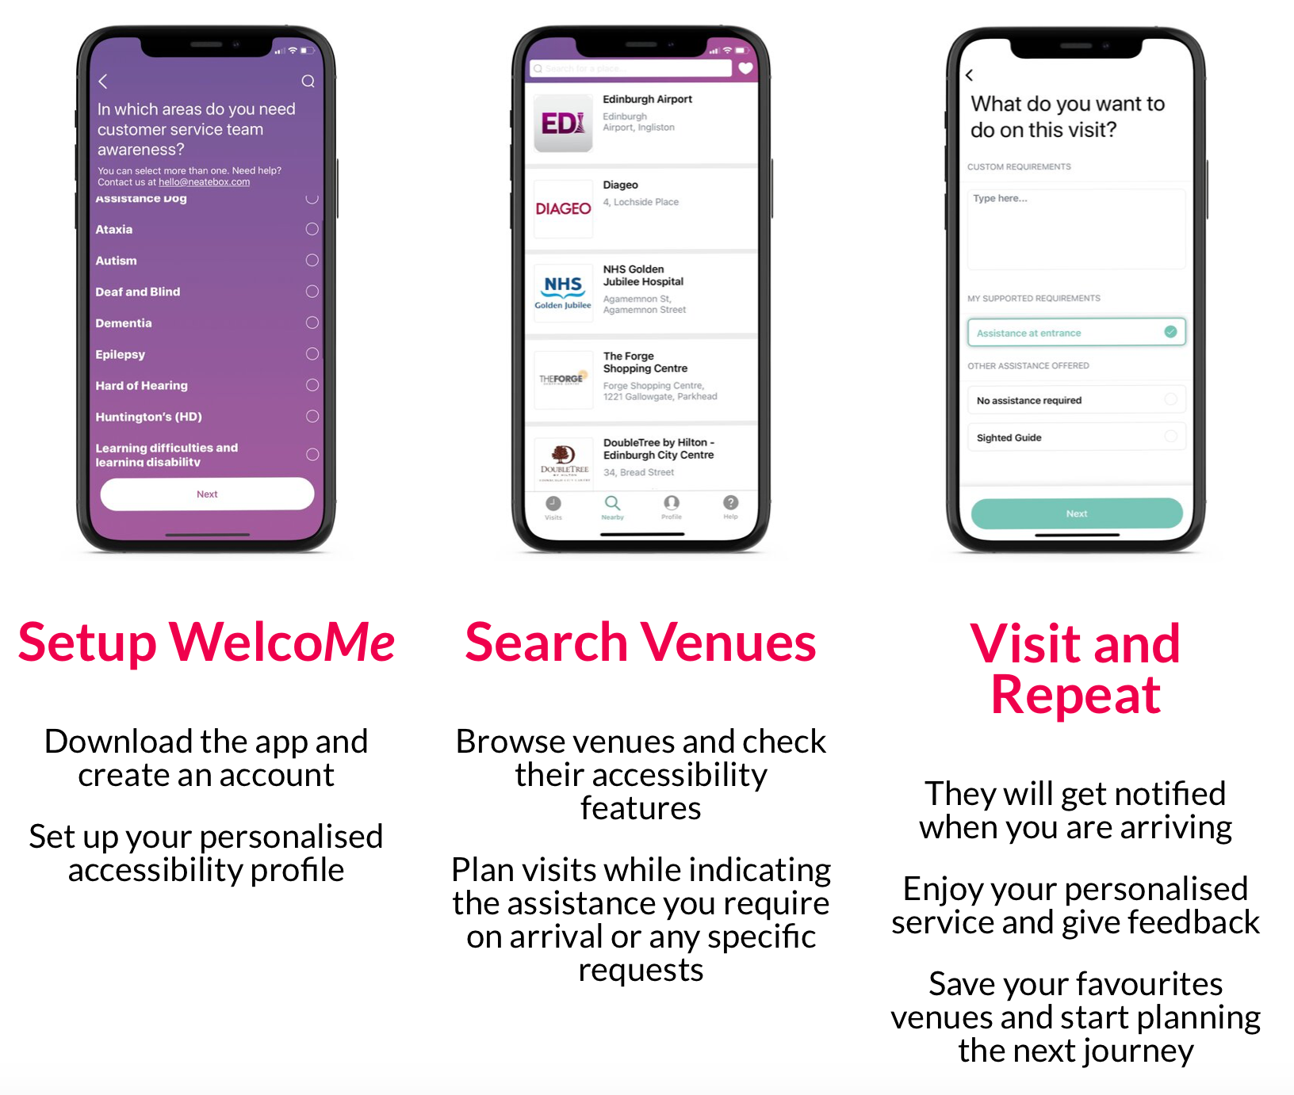
Case Study
The WelcoMe App
UK
The aim of WelcoMe is that every shop or venue offers inclusive service and delivers it in a way that reduces anxiety and increases a customer’s confidence. Through using the app, the venue is notified of a customer’s visit and receives an overview and top tips for customer success to aid their interaction, based on the needs set out by that customer in the app. The customer uses the app to input their intended destination and the app coordinates help as needed upon arrival and throughout service.

Slide 10
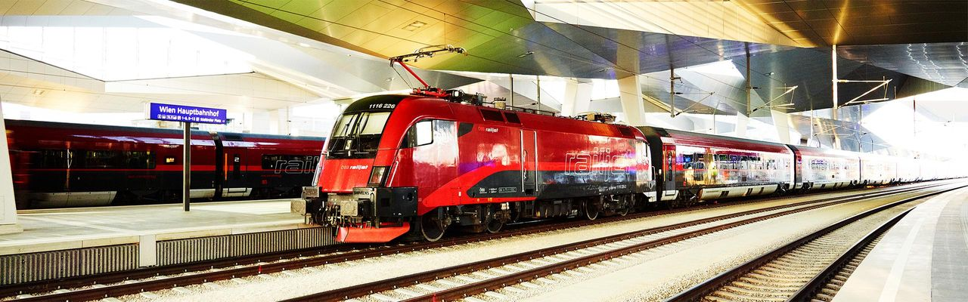
Case Study
E-Paper
Vienna, Austria
Improvement of passenger information at stations by adding to printed timetables. The E-paper system will show the current timetables and will be equipped with a text-to speech mode that will enable blind and visually impaired persons to receive information by voice output.

Slide 11
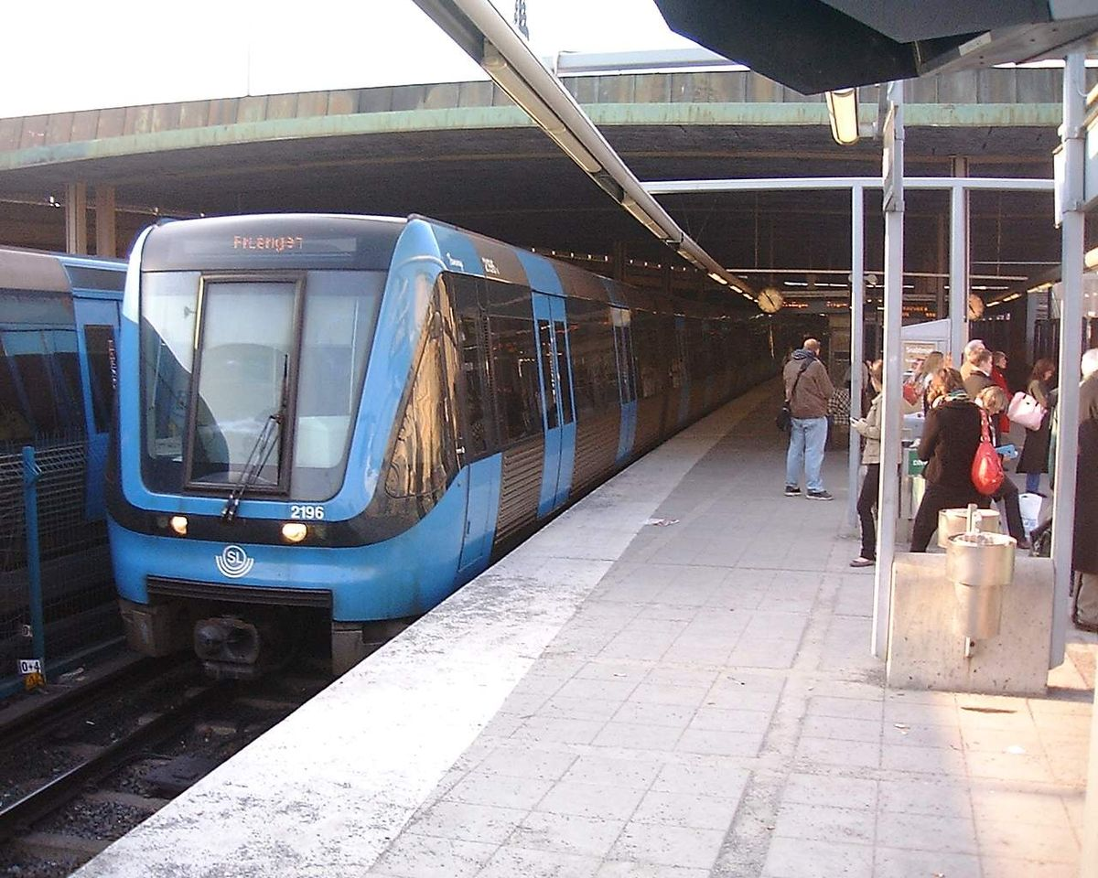
Case Study
Accessible ticket machines in Stockholm
Stockholm, Sweden
Not everyone is always able to validate, activate or change their ticket when there is no train conductor on board. To address this, an accessible ticket machine was designed together with the provider and the organisations for people with disabilities. Touch screen with good contrast, tactile buttons with embossed printing, spoken information, different height, guide path to the ticket machine and multiple languages.

Slide 12
Any questions?
daisy.chamberlain@ktn-uk.org
LinkedIn – Daisy Chapman-Chamberlain
Twitter - @KTM_Rail
Web: https://ktn-uk.co.uk
Notes:
Please do get in touch – I am here to talk and assist

