Slide 1
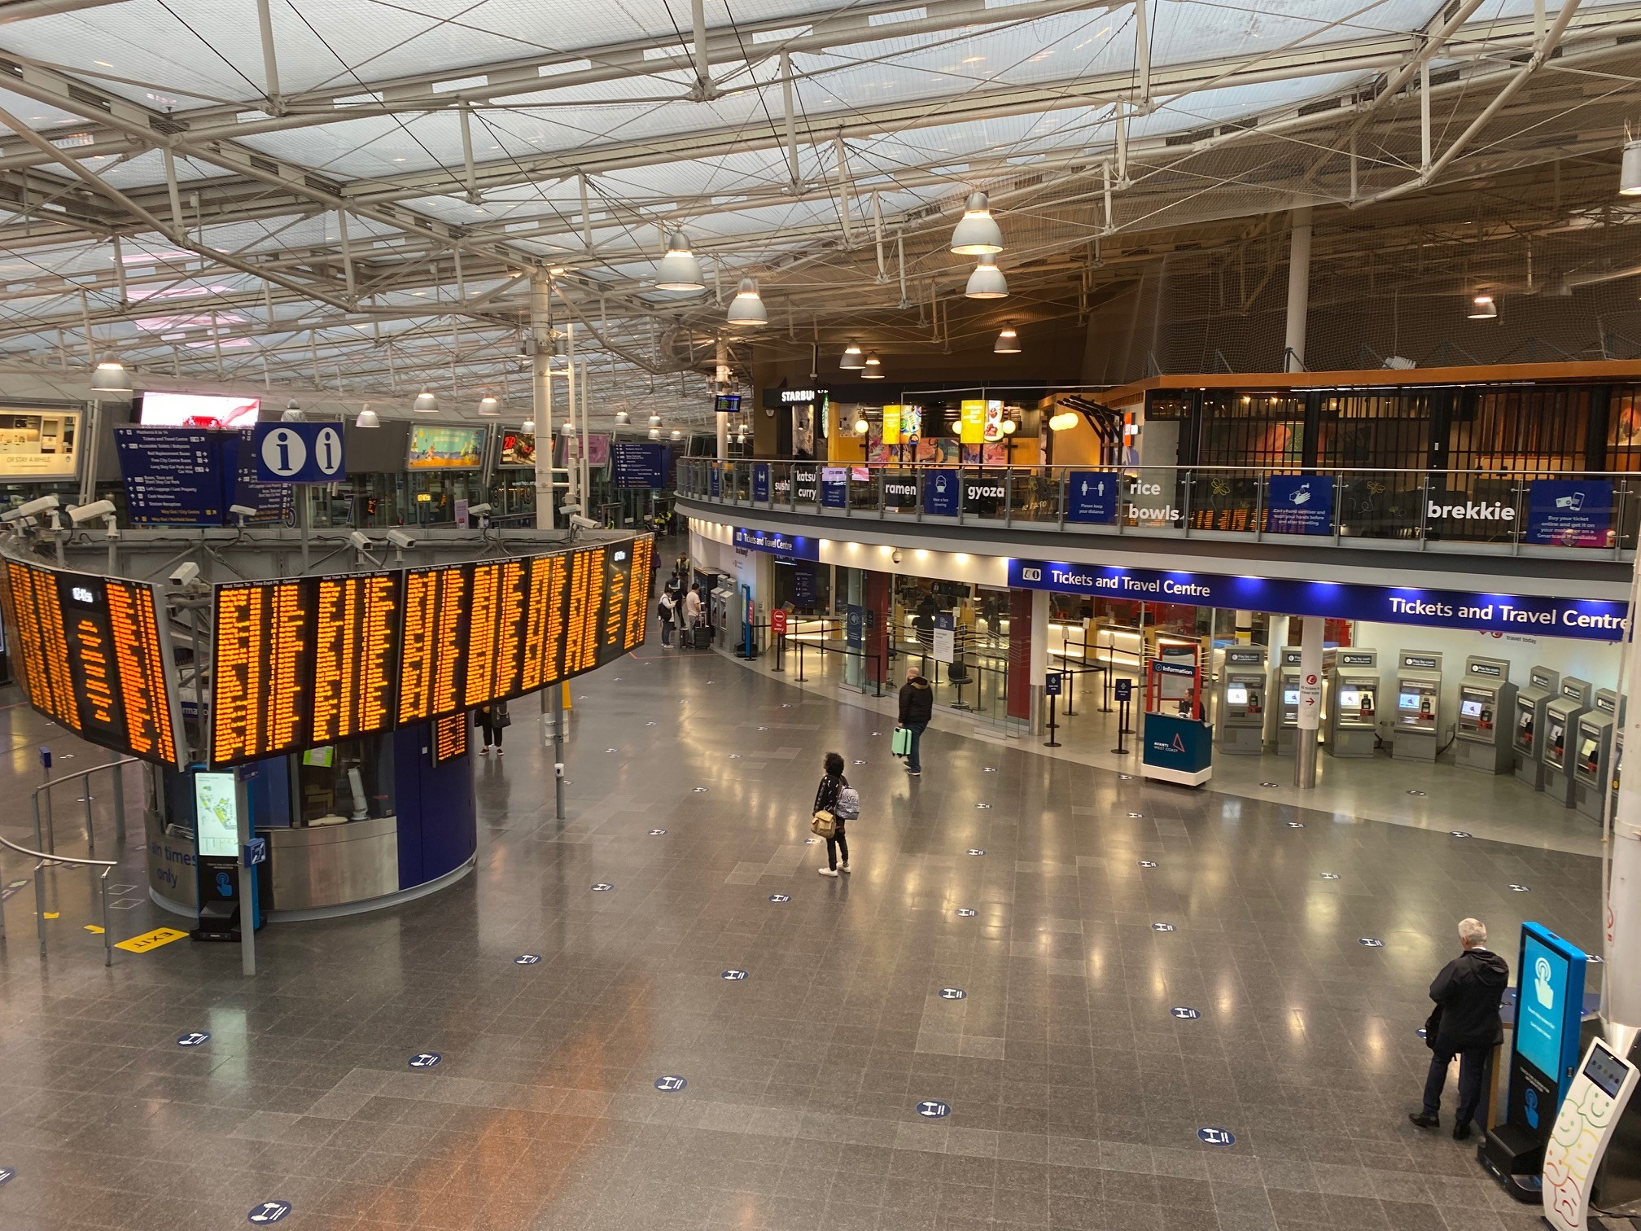
The case for investment in Britain’s stations
September 2021
  RDG Station Investment Webinar

Slide 2
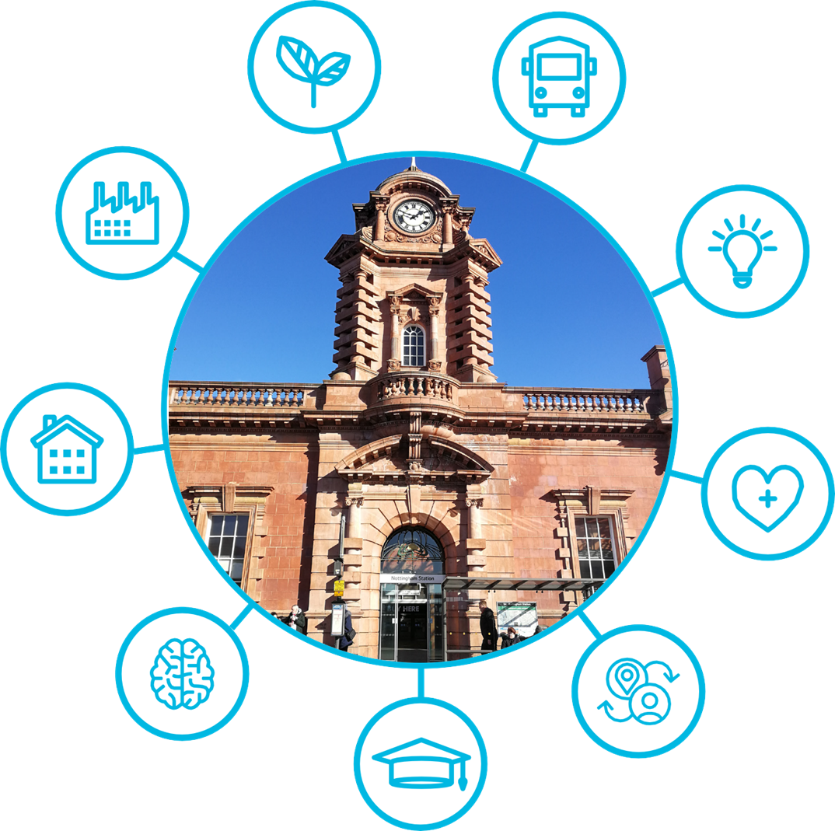
Content
Original Context
Why social value?
Our approach
What we found
The revised context: a changing Britain?
Summary

Slide 3
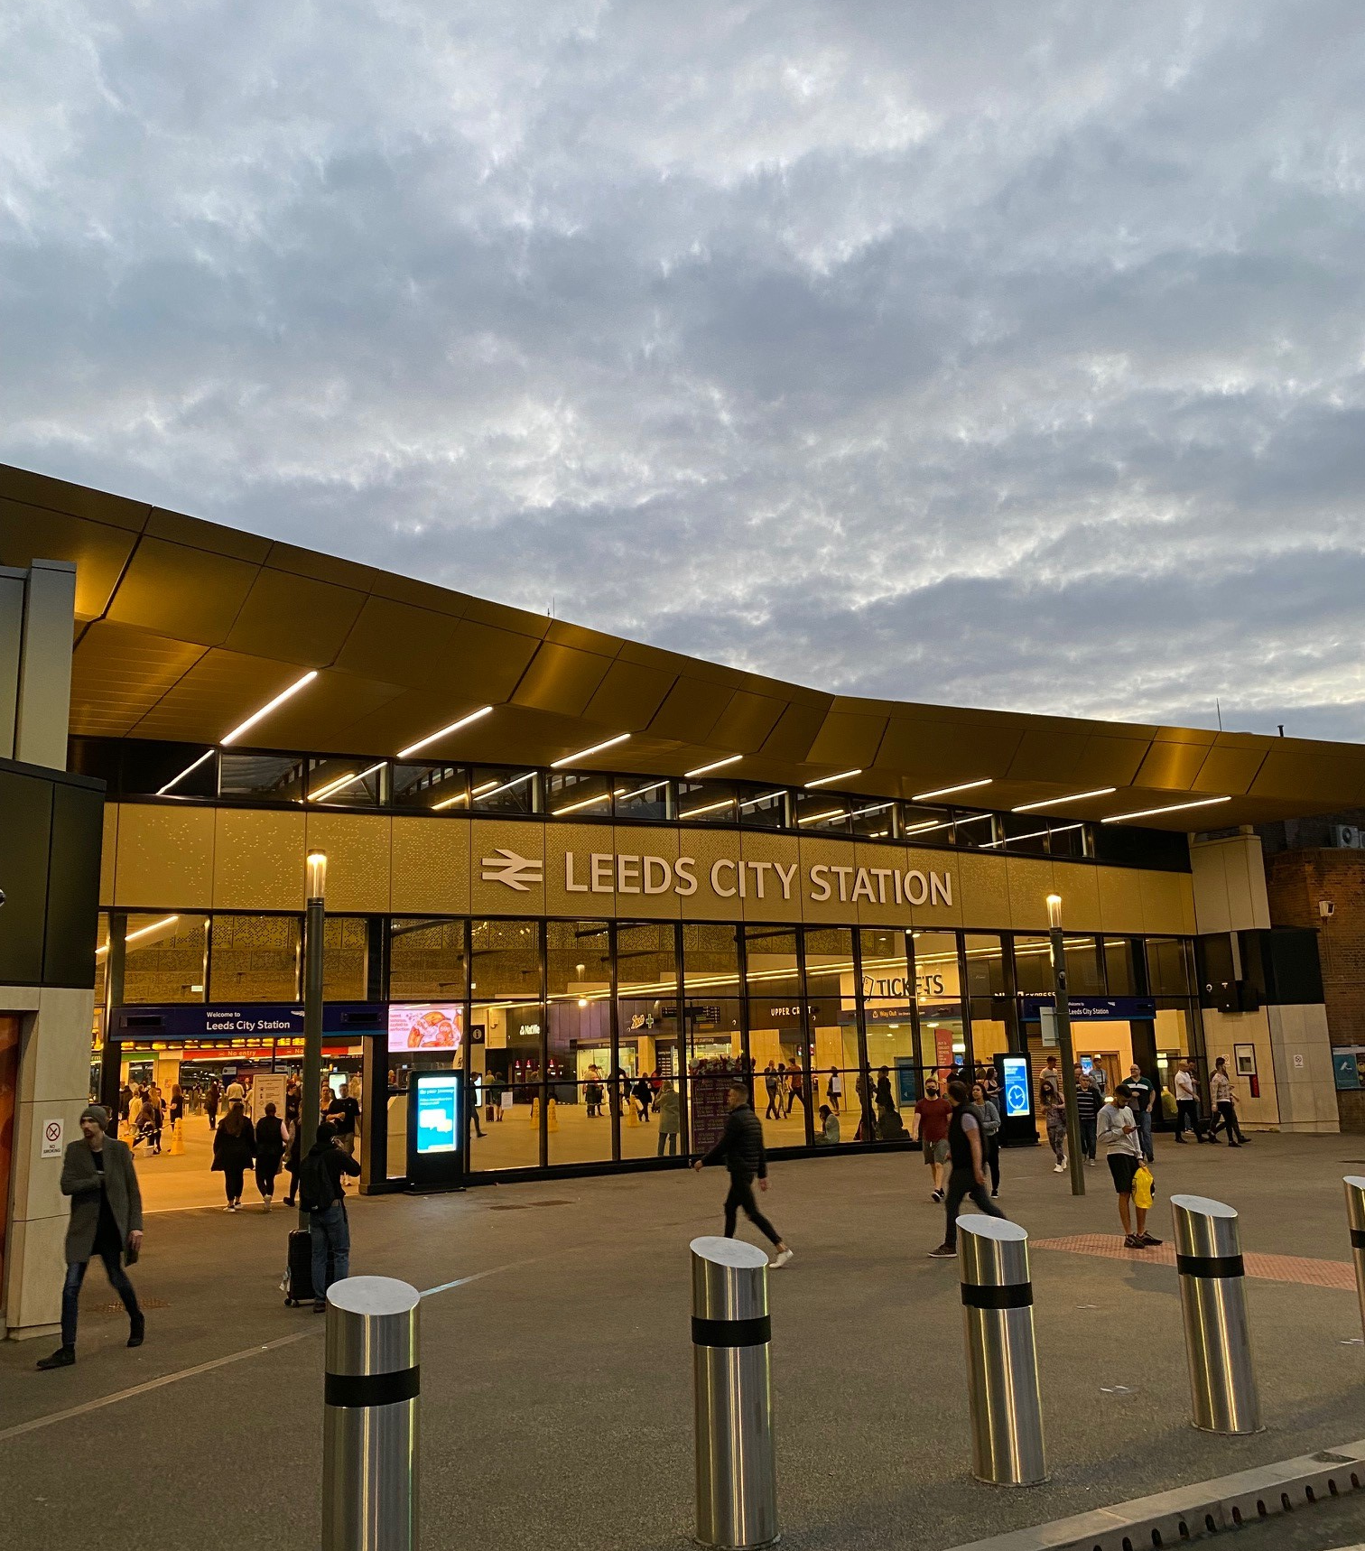
The sheer joy of stations!
Connection – 2.9bn billion station entries and exits in 2019/20
Location – 89% people within a 20-minute cycle ride and 99.6% within a 30-minute drive
Stimulus – “The redevelopment of the station was absolutely fundamental to the regeneration of the area” – Manchester
Pride – “the first ever World Cup of Stations”, “#StationsDay” and Betjeman’s “the most splendid facade in England” (of Huddersfield)
Symbolism – “does not present the image of the conurbation which is attempting to sell itself as the ‘city of business’” – West Midlands

Slide 4
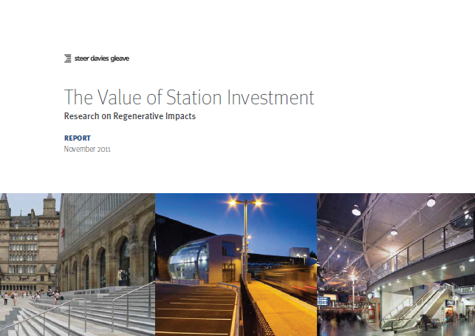
Context for the research – building further evidence
Transport Appraisal
The Vision for Stations - 2015
RDG Case Studies and Six Point Plan - 2018
Local Economic Impacts research - 2018
RSSB Station Sustainability Framework - 2018
Network Rail Design Guidance Manuals
Network Rail Principles of Good Design
3rd Party research, ideas and concepts
Value of Station Investment
Steer - 2011

Slide 5
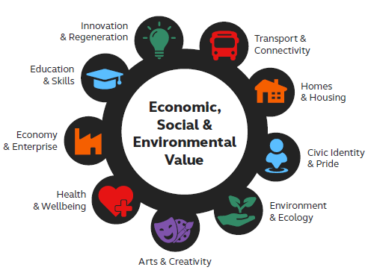
Why did we focus on the concept of Social Value?
Multiple perspectives and aspirations within communities
A framework to support mining of opportunity
A response to both national and local policy agenda
Alignment to existing legislation for Local Authorities
Recognition of Government procurement requirements

Slide 6
Shortlisting approach
Nottingham
Chelmsford
Strood
Burnley Mcr Rd
Idea generation
Sift for focus
Sift for clarity and narrative
Test against counterfactuals
180
36
12
4
Timing sufficient that impact might be seen
Completed and not a new station
Not previously described in previous research or case studies
Ideally ‘discrete investment’ with no material train service impacts
Of material scope and probable impact for the community
Third party participation

Slide 7
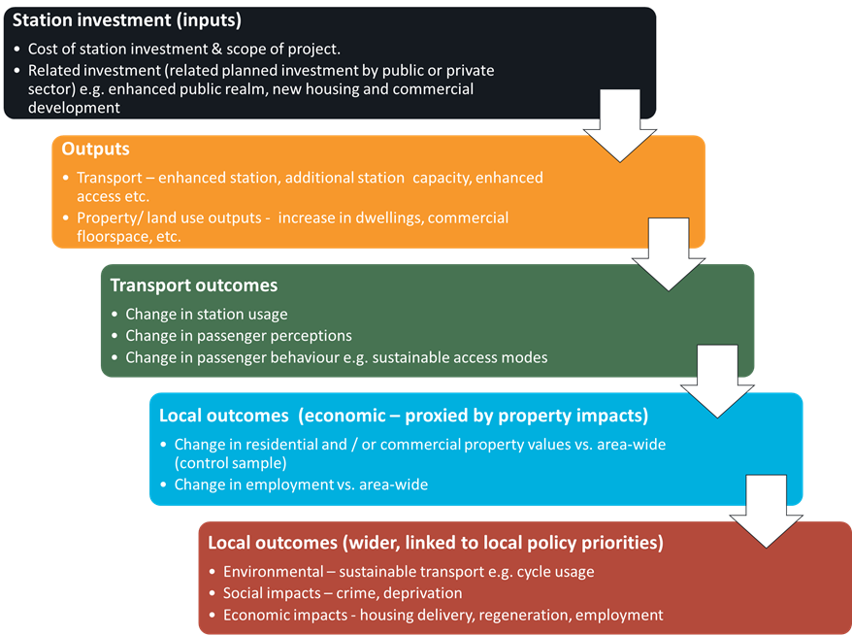
Evidential approach
Data availability and quality remains a material issue even for industry sources
Considered alternative data sources but ruled out for affordability and value
Significant reliance on evidence from local engagement
Planning and development data within 1 mile of the station
We did not seek to create a causal link but looked for evidence of correlation

Slide 8
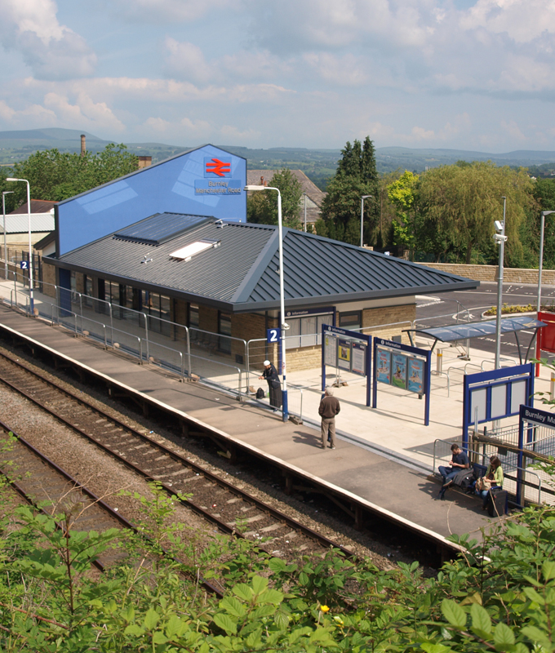
Rail experience and demand
Burnley Manchester Road Station
Nottingham
5.6% footfall increase
16% passenger satisfaction increase
Increased sustainable access
Strood
2.7% footfall increase (compares to zero)
21% satisfaction increase
Burnley Manchester Road *
11.5% footfall increase (inc. some abstraction)
21% passenger satisfaction increase

Slide 9
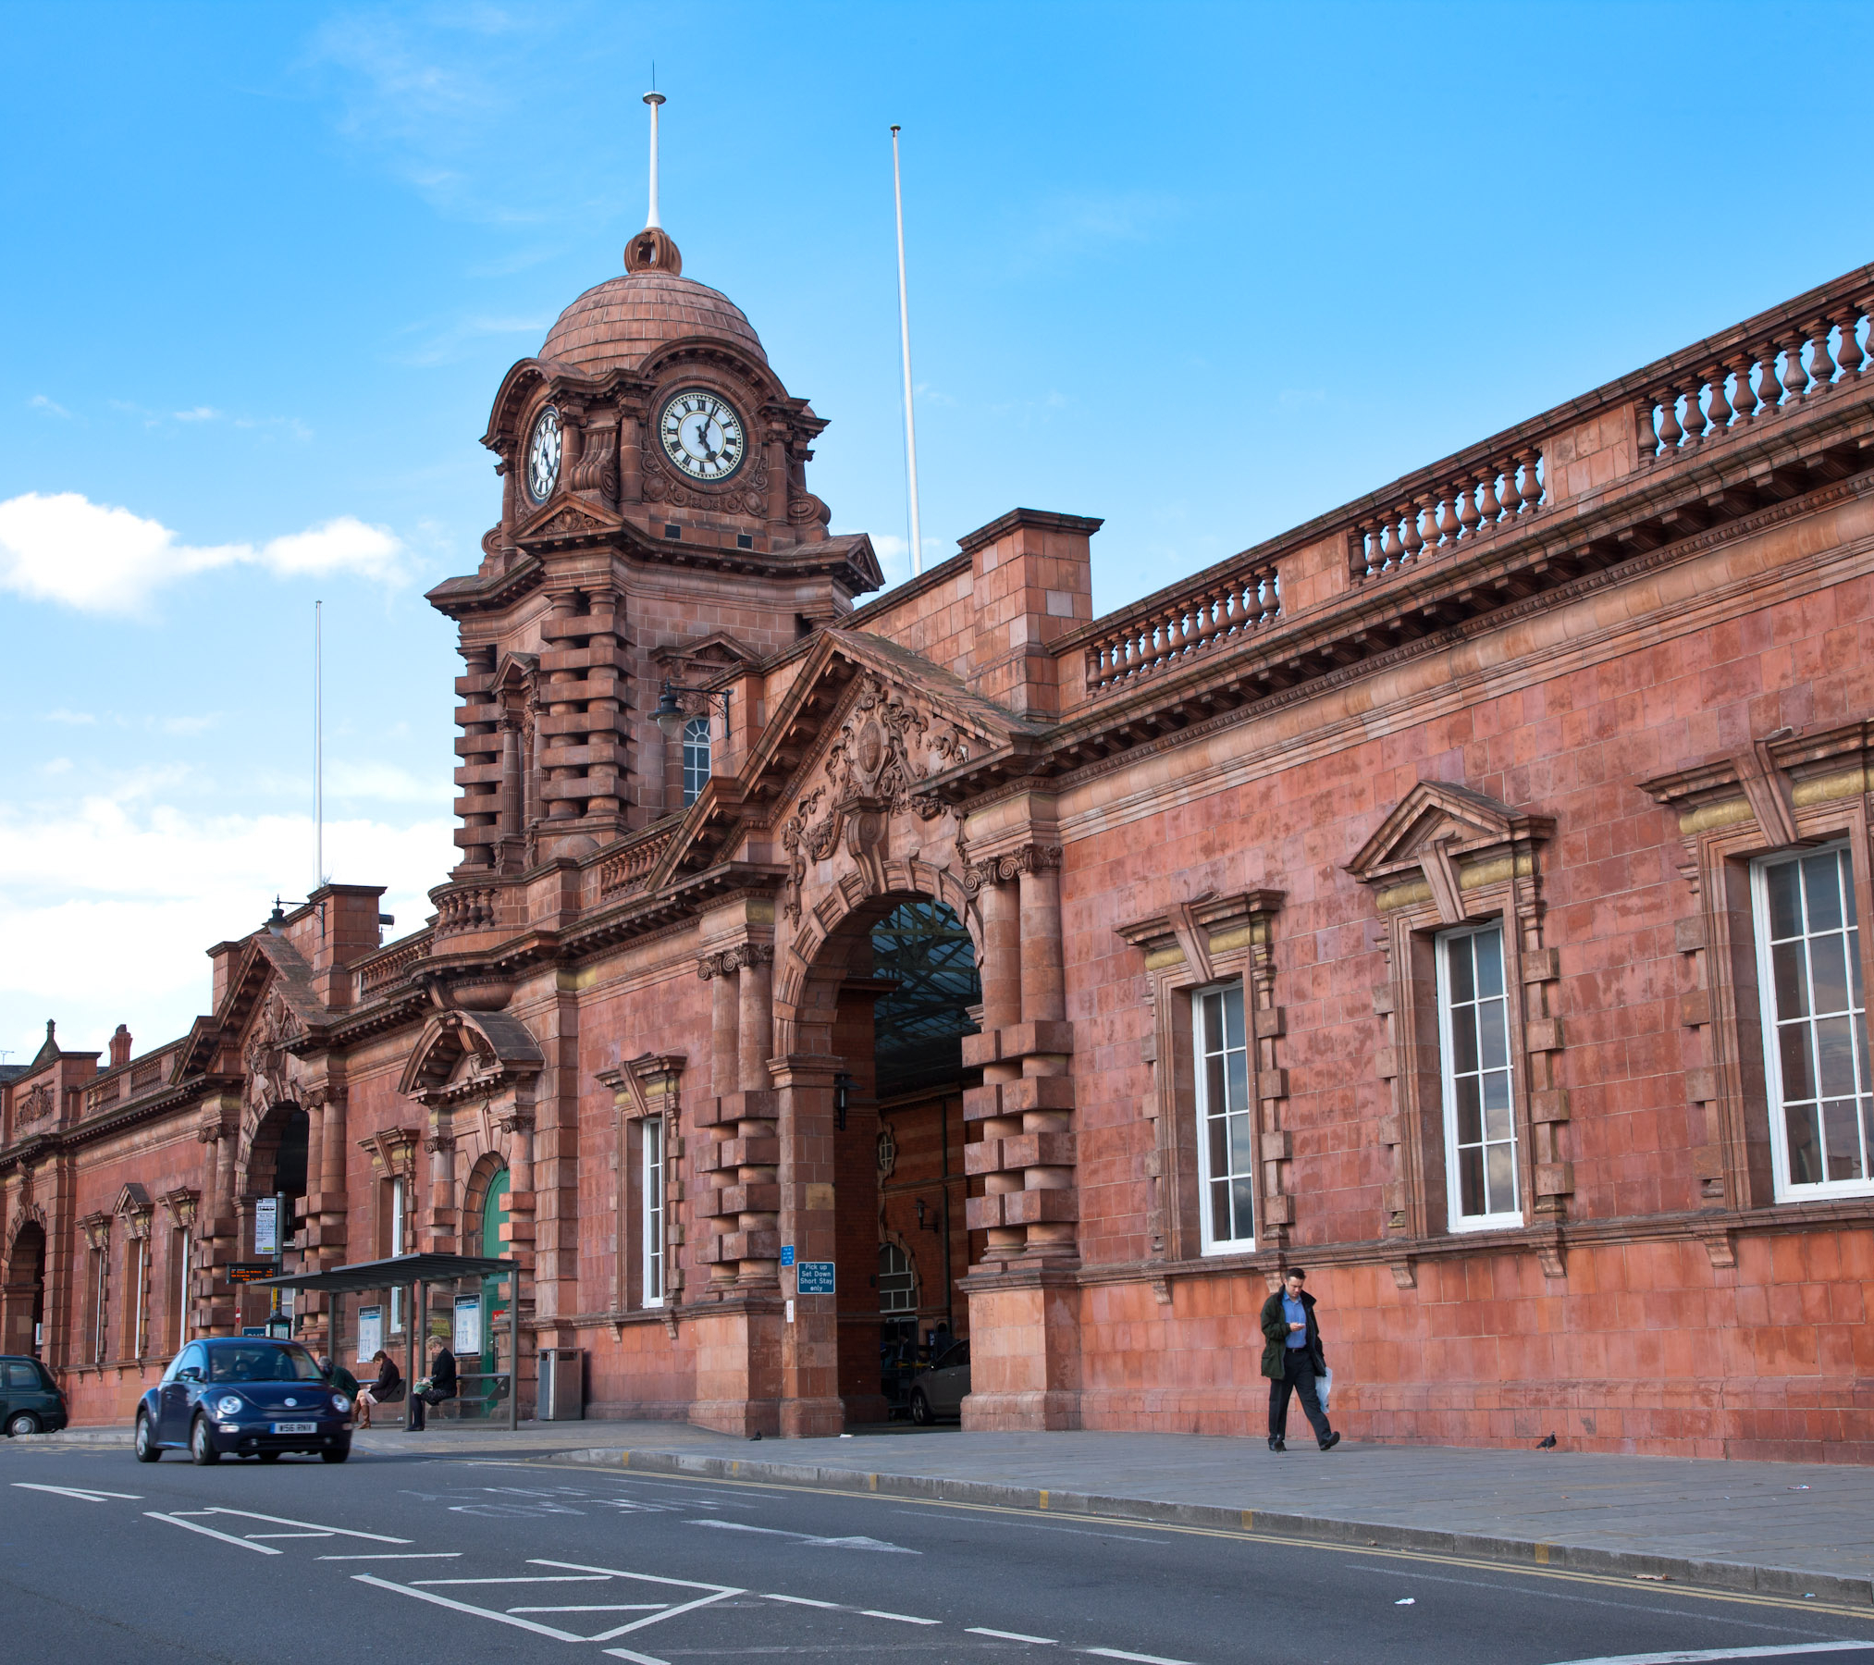
Economic & Property benefits
Nottingham Station
Nottingham
7.6% p.a. house price increase
3.7% employment increase
5.5% tertiary job increase
Increase from 10 to 133 developments p.a.
Chelmsford
4.3% growth in enterprise units (was 2.6%)
900 homes and 30k sqm commercial space
Strood
5.0% rateable value increase
Strood Riverside of 1,200 homes
Burnley Manchester Oxford Road
9.7% house price increase

Slide 10
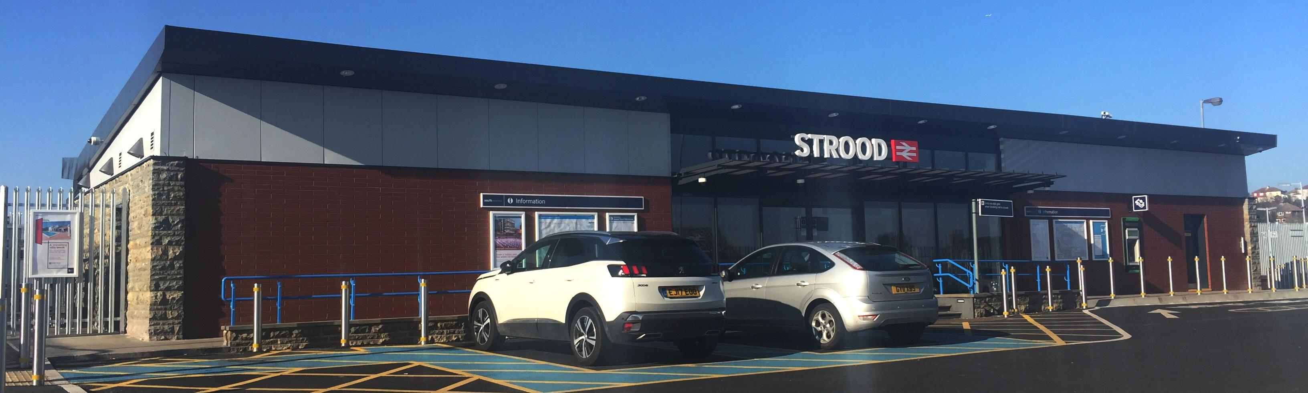
Wider benefits
Strood
Lower crime increase
Station sustainability increase
Public realm contributor
Chelmsford
12% reduction in crime
“Lower emissions and better air quality”
Enhanced environment
Burnley Manc Oxford Road
ASB down by 22%
Community engagement increase
Nottingham
44% increase in city cycling
10pt increase in deprivation in ranking

Slide 11
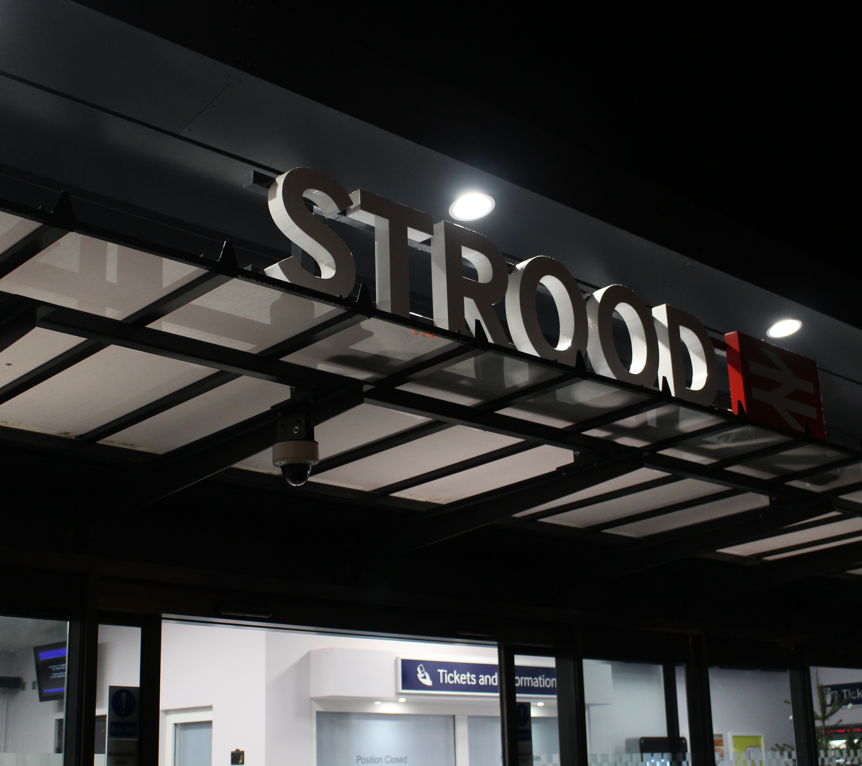
A changing Britain?
Community and local
Discretionary travel
Increased modal competition
Public spending and priorities
Investments need to work harder

Slide 12
Our conclusions
“ strong evidence that station investment can have positive material
outcomes for many of the different aspects comprising Social Value ”
Significant increases in station footfall and passenger satisfaction scores
A correlation between station investment and material increases in house prices, tertiary employment, enterprise units and new developments close to the station
Anecdotal contribution to the wider elements of social value for communities
Importance of working early on to draw together different perspectives and objectives to create schemes with greatest potential impact and chance of success
More can be done to capture impacts and evidence contribution

